Slide 1

Para-Rowing Specific Coaching Considerations
VISUAL IMPAIRMENT
September 2019

Slide 2


Slide 3


Slide 5

Visual Impairment
Rowing is a sport where someone can take part and compete without major accommodations. In coaching rowers with a visual impairment, there are a few principles that can assist a coach in providing the best possible learning environment.
Exercise – otherwise sedentary lifestyle
Balance – impact of VI
Kinaesthetic Sensation – muscular/joint, weight
The Psychological/Social Sector – integration with sighted peers
Notes:
Rowing is a sport where someone can take part and compete without major accommodations. In coaching rowers with a visual impairment, there are a few principles that can assist a coach in providing the best possible learning environment.
Motor Sector
Visual impairment can cause certain motor problems such as a difficulty in attitude, integration and body-awareness including balance problems; motor coordination; posture and orientation difficulties.
Apart from the numerous motor and physical qualities that rowing helps to develop in sighted rowers, it is useful to mention that these are also indispensable for the athlete with a visual impairment.
Balance
This is a fundamental element of rowing in a boat (as opposed to land based rowing machines) for an individual with a visual impairment
Exercise
Exactly the same as with the sighted population, improved control over the motor forces, such as strength, speed and flexibility, whilst providing an efficient cardio-vascular form of exercise, which can be used to combat the consequences of visual impairment, which can otherwise include a sedentary existence/lifestyle.
Kinaesthetic Sensation
It can be said that visual impairment does not constitute a serious problem for performing the rowing movement. In practice a sighted rower does not constantly look at his/her blade or crewmembers but relies on an instinctive ‘feel’ for the boat. An athlete with a visual impairment is therefore not impaired in the discovery of these physical sensations or their refinement.
The Psychological/Social Sector
A disability of any kind can entail isolation and a sedentary existence. Membership of a rowing club provides an opportunity to get out of ‘special schools’ and other disabling environments to meet other people and measure against them on an equal basis.
As with the sighted population, someone with a visual impairment will learn through their participation in rowing character-building components, friendships and numerous values.

Slide 6
Visual Impairment
Many of the principles applied when delivering effective coaching will apply to coaching any athlete, and can be summarised as follows:
Visually impaired or blind (congenital or acquired)?
Begin with an orientation to the Rowing environment
Use verbal descriptions to supplement demonstrations
Integrate those with and without visual impairments into crews
Classification
Challenge athletes with a VI
No two visual Impairments are the same
Visual Impairment and single sculling
Be innovative
Notes:
Many of the principles applied when delivering effective coaching will apply to coaching any athlete, and can be summarised as follows:
Visually impaired or blind?
It is important to understand that there will be a large range of sight loss amongst participants who are eligible (10% - 100% loss of visual acuity and/or visual fields).
Orientation to the rowing environment
When coaching an athlete with limited or no vision, begin with an orientation to the rowing environment, i.e. ergometer, rowing tank, clubroom, boathouse, pontoon/shoreline. Allow the athlete to become aware of his/her surroundings through exploration with verbal descriptions, noting any potential hazards, such as steps, riggers, and floor obstacles in the boathouse. It is worth remembering that individuals with congenital sight loss are most concerned with what obstacles are within a 0.5m perimeter. This will allow the individual to become as self-sufficient as possible.
Use verbal descriptions to supplement demonstrations
Be as exact and descriptive as possible and ensure that your language is appropriate to the individual. For example, when describing the on-water circulation pattern, rather than saying “from that end to that end”, describe an east/west or north/south clockwise/anticlockwise pattern.
Avoid using terminology or phrases that imply some visual reference where the athlete may not be able to understand, such as “square/feather the blade”. These terms that rely on visual cues are not always helpful to individual with sight loss and can be confusing. Clearly describe the rowing oar together with the articulation to the swivel/oarlock and encourage the person to have a tactile reference.
Explain the action of the blade together with the medium through which the blade moves – water. If a facility such as a rowing tank is available or a ‘bank-tub’ this can be a valuable, safe introduction to the sport providing physical cueing and facilitation of the stroke mechanics.

Slide 7
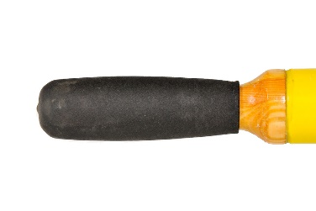
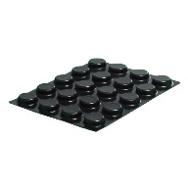
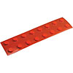
Innovation
Innovation
Be innovative as a coach and employ some of the principles that you would use for a sighted rower. Consider placement of drinking straws to the sax-board of the boat, to enable the athlete to brush with their hands, in order to help achieve correct catch height and placement.
Use of tactile markers on the oar or scull handles to indicate when the blade is “square” to the water. These can be easily removed, once the rower has learnt the skill.
Notes:
Integrate those with and without visual impairments into crews
Fully integrate athletes with a visual impairment into ‘mainstream’ crew boats wherever possible, but also permit opportunities for competition and training with other rowers with a visual impairment who may wish to take part in competition.
Classification Understand the FISA and IBSA classification system.
Challenge athletes with a VI
Challenge the athlete with a visual impairment just as you would any other athlete. Involve athletes in all crew activities, including carrying the boat, and working with cox/coach to prepare boat set-up. This is particularly important when athletes with a VI who are integrated into mainstream rowing practice.
No two visual Impairments are the same – acquired or congenital sight loss?
It is important for coaches to understand and distinguish between acquired and congenital sight loss together with the likely implications for effective coaching. A rower who has acquired sight loss but learnt to row or scull with some degree of vision will likely have an advantage over someone with congenital blindness with respect to coordination of body movements and the ability to produce good rowing technique. Many biomechanical studies have been carried out looking at gait analysis of sprinters showing the advantage that an individual with acquired sight loss has over congenital sight loss in stride pattern. Teaching the basic rowing stroke to someone with congenital sight loss will require more consideration on the part of the coach with regards to choice of words, kinaesthetic feel and explanation of the rowing vocabulary.
Innovation
Be innovative as a coach and employ some of the principles that you would use for a sighted rower. Consider placement of drinking straws to the sax-board of the boat, to enable the athlete to brush with their hands, in order to help achieve correct catch height and placement.
Use of tactile markers on the oar or scull handles to indicate when the blade is “square” to the water. These can be easily removed, once the rower has learnt the skill.
Visual Impairment and single sculling -The athlete with a visual impairment should be encouraged to single scull, provided that a simple ‘risk assessment’ has been carried out. Safety boat cover should be provided and assistance with steering may be given using a radio link.

Slide 8
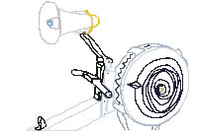
Aids in Training
ErgChatter is a free software tool that gives a voice to your PM3 or PM4. Perfect for rowers with visual impairment, ErgChatter announces your performance data at regular intervals as you row.
http://www.concept2.com/service/software/ergchatter
http://www.concept2.co.uk/indoor-rowers/adaptive-rowing/rowing-visually-impaired
The Remote Coxswain is a tool that allows rowers with a visual impairment to participate in recreational and competitive rowing. This remote-controlled rudder ensures that the boat goes in the right direction, while the custom-fitted paddles let the rower know that they are gripping properly. This hardware can be retrofitted onto any racing shell.
http://www.remotecoxswain.com/product.html
Notes:
ErgChatter is a free software tool that gives a voice to your PM3 or PM4. Perfect for rowers with visual impairment, ErgChatter announces your performance data at regular intervals as you row.
http://www.concept2.com/service/software/ergchatter
http://www.concept2.co.uk/indoor-rowers/adaptive-rowing/rowing-visually-impaired
The Remote coxswain
The Remote Coxswain is an affordable tool that allows those with sight disabilities to participate in recreational and competitive rowing. This innovative remote-controlled rudder ensures that the boat goes in the right direction, while the custom-fitted paddles let the rower know that they are gripping properly. This hardware can be retrofitted onto any racing shell. http://www.remotecoxswain.com/product.html

Slide 9
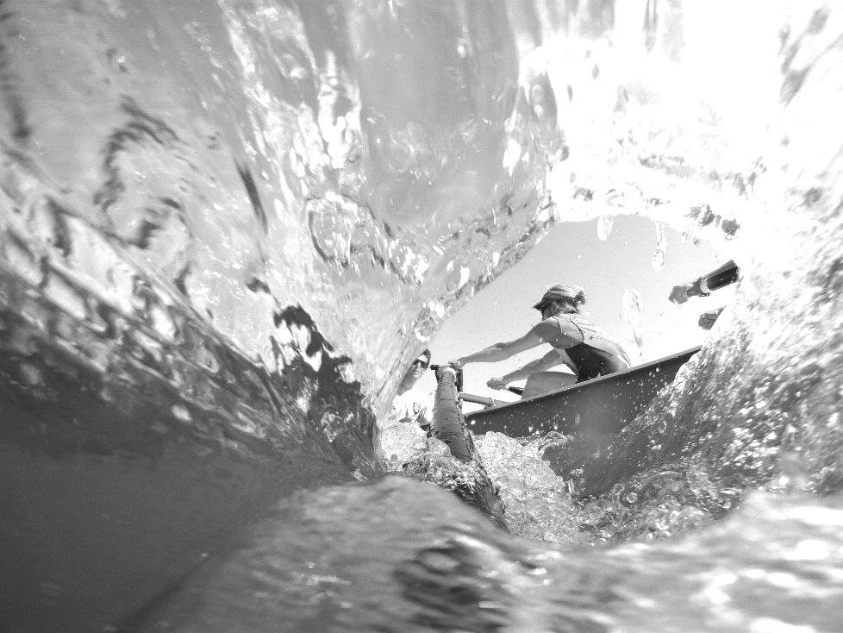

Thank you !
Thank you!

