Slide 1

Para-Rowing Equipment & Regulations
September 2019

Slide 2
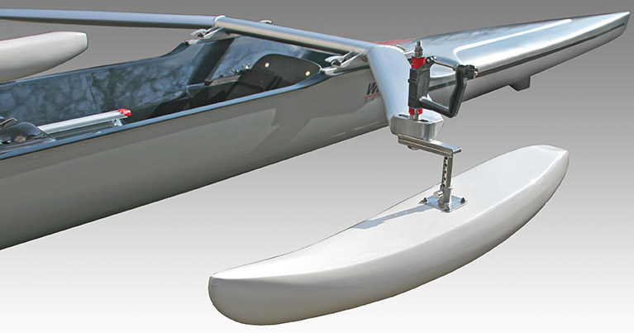
Notes:
Para-Rowing uses equipment that is adapted to enable the individual to take part in the sport.
The World Health Organisation developed the International Classification of Functioning, Disability and Health (ICF) as a way of documenting and categorising the function of all individuals with and without disabilities (World Health Organisation, 2002)
Body Function and structure (the functions that a body can perform based on physiology and anatomy – PR3; PR2; PR1
Activity and participation (the activities or skills that can be performed and how those skills can be used to participate in Rowing)
Environment and context (the influence of factors external to the individual – water)
This ICF model closely parallels the major categories of equipment that are used in rowing:
Personal equipment (something that the rower wears designed to enhance body function such as prosthetic limb or orthosis)
Activity-specific equipment (designed to enhance the performance of an activity or participation in a specific sport – Rowing: postural support seat, pontoons, strapping, and hand gloves etc)
Environmental technology (used to modify the facilities or environment in which the sport is played)

Slide 3

WHO ICF
      The World Health Organisation developed the International Classification of Functioning, Disability and Health (ICF) as a way of documenting and categorising the function of all individuals with and without disabilities (World Health Organisation, 2002)
      Body Function and structure - the functions that a body can perform based on physiology and anatomy: PR3; PR2; PR1 (legs-trunk-arms)
      Activity and participation - the activities or skills that can be performed and how those skills can be used to participate in Rowing
      Environment and context - the influence of factors external to the individual i.e. wind, water

Slide 4
ICF Model Applied to Para-Rowing Equipment
This ICF model closely parallels the major categories of equipment that are used in rowing:
      Personal equipment - something that the rower wears designed to enhance body function such as prosthetic limb or orthosis
      Activity-specific equipment - designed to enhance the performance of an activity or participation in a specific sport: postural support seat, pontoons, strapping, prosthesis etc
      Environmental technology - used to modify the facilities or environment in which the sport is played, such as access to water
Notes:
Para-Rowing Equipment
Para-Rowing uses equipment that is adapted to enable the individual to take part in the sport. The way people adapt to their disability is an individual process. Two rowers with the same disability may require completely different equipment modifications, so it is important to work with athletes to determine what is optimal to enhance their rowing activity.
Personal equipment (something that the rower wears designed to enhance body function such as a prosthetic limb or orthosis)
Activity-specific equipment (designed to enhance the performance of an activity or participation in rowing, such as a postural support seat, pontoons, strapping, hand-gloves, prosthetic attachment to footplate.

Slide 5
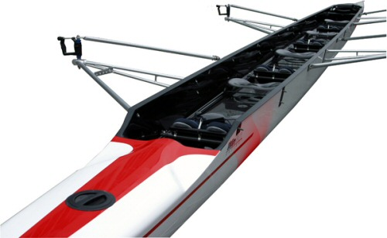
PR3
PR3
When considering a suitable boat for PR3 athletes many of the principles that apply to able bodied rigging set-ups will apply.
Considerations should be given to the following:
      Mixed gender crews (strength, height, stroke length)
      Disability mix within boat (physical, visual, learning)
      Mobility range of athlete
      Use of orthotics or prosthetics for amputees and the effect of these on their stroke length and balance
Notes:
For athletes classified in the PR3 category, standard equipment that complies with the FISA Rules of Racing are generally used. No further restrictions shall apply.

Slide 6
PR2
PR2 rowers are required to comply with the following –
http://www.worldrowing.com/mm//Document/General/General/13/08/95/Appendix18-ParaCompetition2018update_Neutral.pdf
      Fixed seat
      Knee strap (optional)
      Lap/hip strap (optional)
      Seat back may be removed
      Rigger with reduced span
      Shorter overall length of oars/sculls and reduced inboard
      Pontoons optional
Notes:
Example below of a typical PR2 double scull which has a fixed seat and may have stabilising pontoons. The hull, the pontoons where fitted, and the seat fixing are part of the Standard specifications. The seat itself and the rigger design of the FISA Standard PR2 double scull are not restricted.

Slide 7
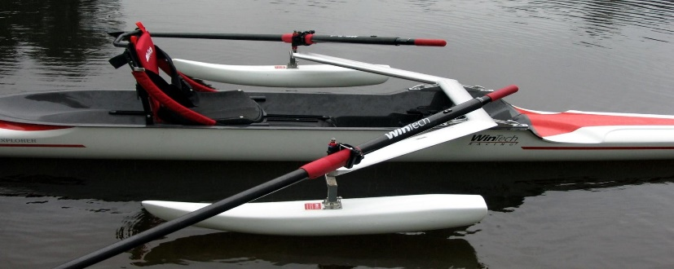
PR1
The seat itself and the rigger design of the Standard PR1 single scull are not restricted, except that the design of the rigger must allow the stabilising pontoons to be correctly fixed.
http://www.worldrowing.com/mm//Document/General/General/13/08/95/Appendix18-ParaCompetition2018update_Neutral.pdf
      Fixed seat
      Chest strap (required)
      Knee strap (optional) over thighs as close to the knee as possible
      Pontoons (required)
      Narrow span rigger
      Shorter oars (no overlap)
Notes:
The Standard Para-Rowing single scull has a fixed seat and must have stabilising pontoons installed, attached to the riggers at a minimum distance of 600mm from the centreline of the boat as detailed in the FISA Para-Rowing Competition Regulations. The hull, the pontoons and the seat fixing are part of the standard specifications.

Slide 8
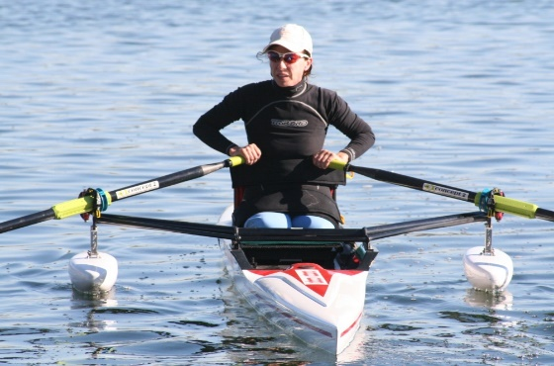
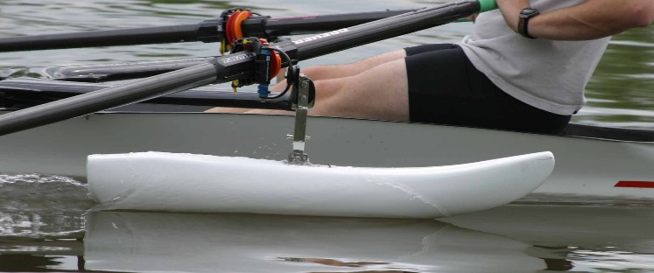
Pontoons
Notes:
The provision of stabilising pontoons for PR1 provides a more stable platform, by providing additional lateral stability for rowing shells.
For safety reasons and fairness during competition, the pontoon attachment to the riggers should be no further inboard than 600mm from the centreline of the boat.
IMPORTANT:
FISA recommends that caution is taken with rowers who rely on pontoon floats for stability when changing rigger spans. By bringing the pins towards the centreline of the boat, stability will be compromised.

Slide 9
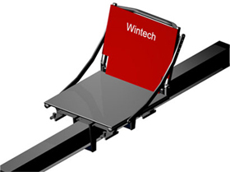
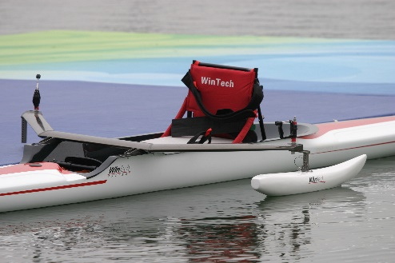
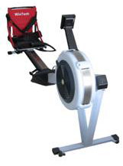
Seats
Adaptive Rowers in the PR1 category are likely to have compromised sitting balance and require a postural support seat on the rowing ergometer and in the boat.

Slide 10
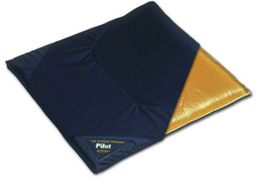
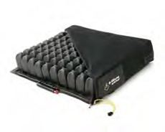
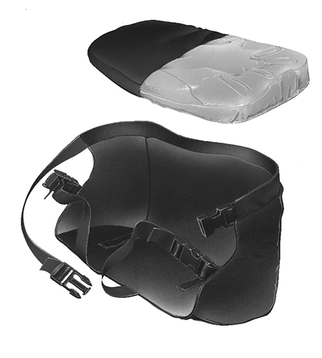
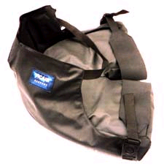
Seat Cushions & Tissue Protection
Notes:
Seat cushions
Caution:
Individuals who may be predisposed to developing pressure sores, such as persons with spinal cord injury should seek medical advice as to the most suitable interface between themselves and the seat. Cushions should not only provide comfort but help protect against the direct sitting pressures and shearing forces incurred in rowing.
Prevention is always better than cure and that is very true for lessening the chances of getting a pressure sore during rowing. Individuals particularly at high-risk include those with spinal cord injury and other conditions which cause a loss of sensation. Important to remember that Rowing is one of the most dynamic of all seated sports.

Slide 11
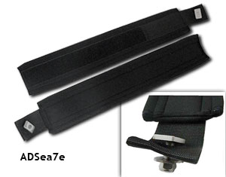
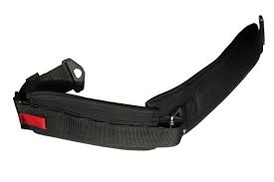
Body Strapping
The use of strapping is primarily safety to ensure that the rower is supported in the seat and enhance performance for PR1 and PR2 rowers.

Slide 12
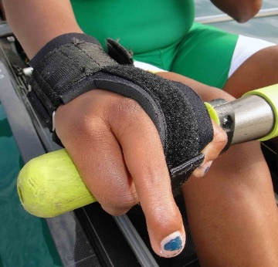
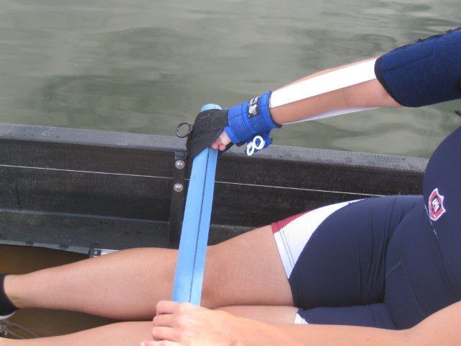
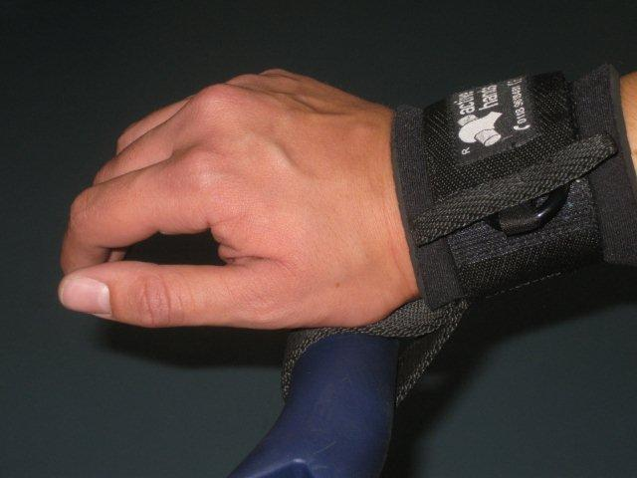
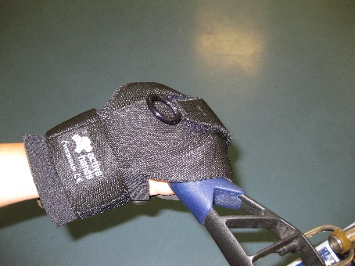
Hand Strapping/Gloves
Notes:
Active Hand Splints (General Purpose Gripping Aid - AH1)
The Active Hands™ general purpose gripping aids consist of a self-closing Velcro glove which tensions to wrap fingers around oar/scull handle are widely used by Adaptive Rowers ideal for those with tetraplegia/quadriplegia, cerebral palsy, stroke recovery, finger amputees or any disability that affects hand function. It functions by the tightening of a strap in the upper section, which gently pulls the hand into a fist shape, in order to facilitate an ergometer, oar or scull handle. The wrist strap is also adjustable and the aid is padded to reduce chafing
Looped Exercise Aids (AH3)
Ideal for use on the ergometer, the Looped Exercise Aids feature strong loops which can be slipped over the handle with an adjustable padded wrist strap. When not under tension, the aids easily slide on and off the handle, allowing complete individual independence and ability to ‘let go’ during rest periods
https://www.activehands.com

Slide 13
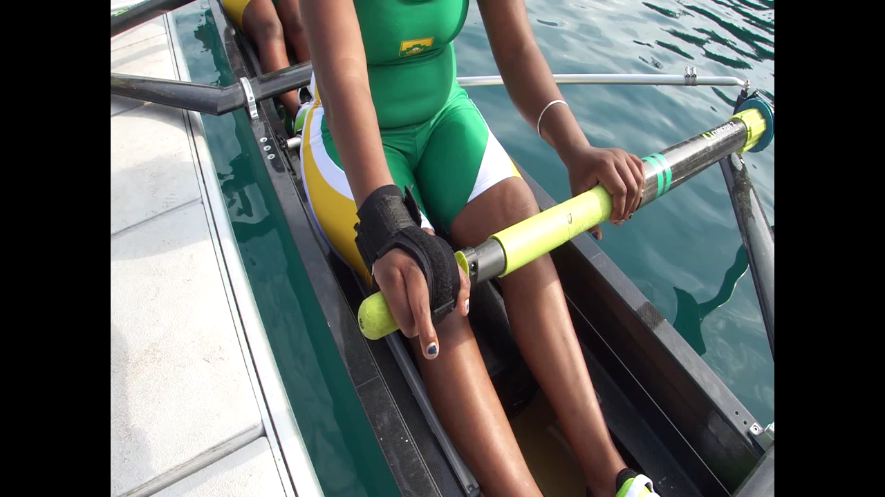
Release of additional straps

Slide 14
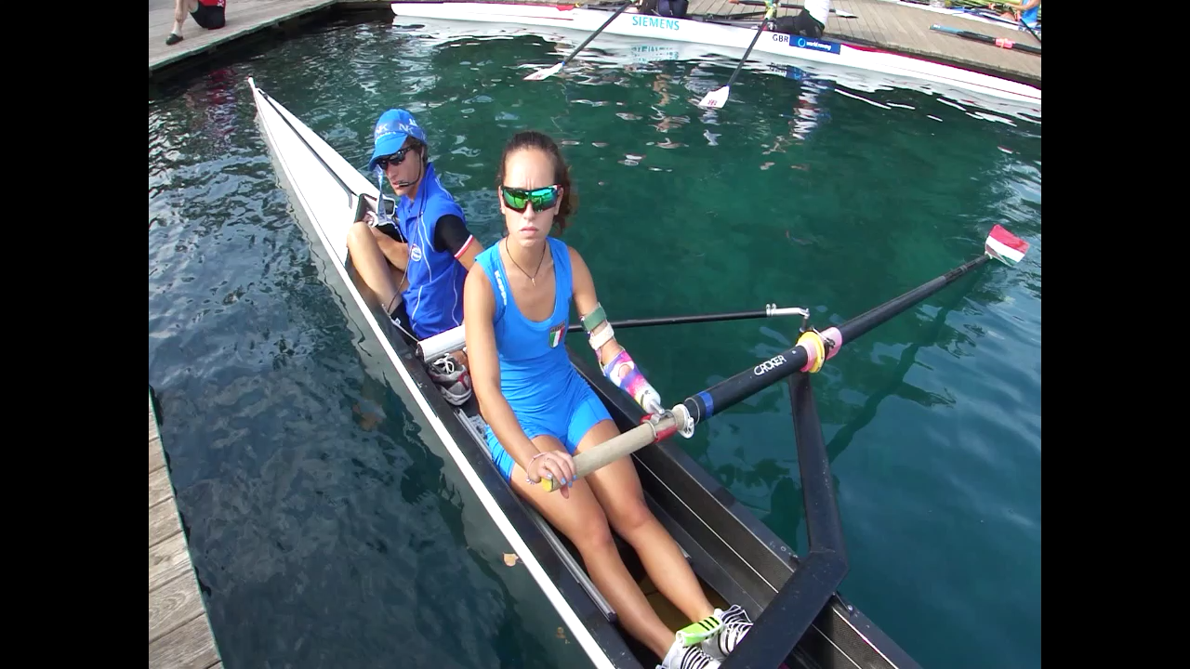

Slide 15
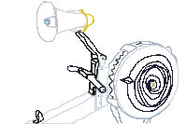
Visually impaired Aids
ErgChatter is a free software tool that gives a voice to your PM3 or PM4. Perfect for rowers with visual impairment, ErgChatter announces your performance data at regular intervals as you row
The Remote Coxswain is an affordable tool that allows those with sight disabilities to participate in recreational and competitive rowing. This innovative remote-controlled rudder ensures that the boat goes in the right direction, while the custom-fitted paddles let the rower know that they are gripping properly. This hardware can be retrofitted onto any racing shell.
Notes:
ErgChatter is a free software tool that gives a voice to your PM3 or PM4. Perfect for rowers with visual impairment, ErgChatter announces your performance data at regular intervals as you row.
http://www.concept2.com/service/software/ergchatter
http://www.concept2.co.uk/indoor-rowers/adaptive-rowing/rowing-visually-impaired
The Remote coxswain
The Remote Coxswain is an affordable tool that allows those with sight disabilities to participate in recreational and competitive rowing. This innovative remote-controlled rudder ensures that the boat goes in the right direction, while the custom-fitted paddles let the rower know that they are gripping properly. This hardware can be retrofitted onto any racing shell.
http://www.remotecoxswain.com/product.html

Slide 16
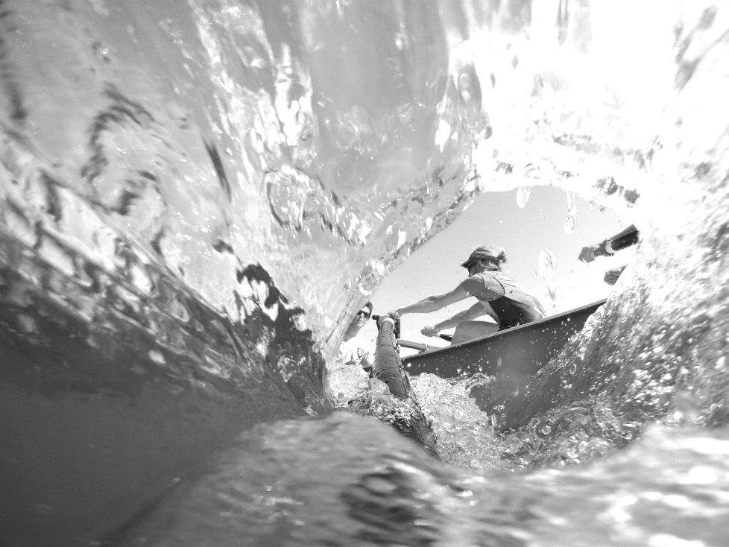

Thank you !
Thank you!

