Slide 1

Establishing a Para-Rowing Programme
September 2019

Slide 2
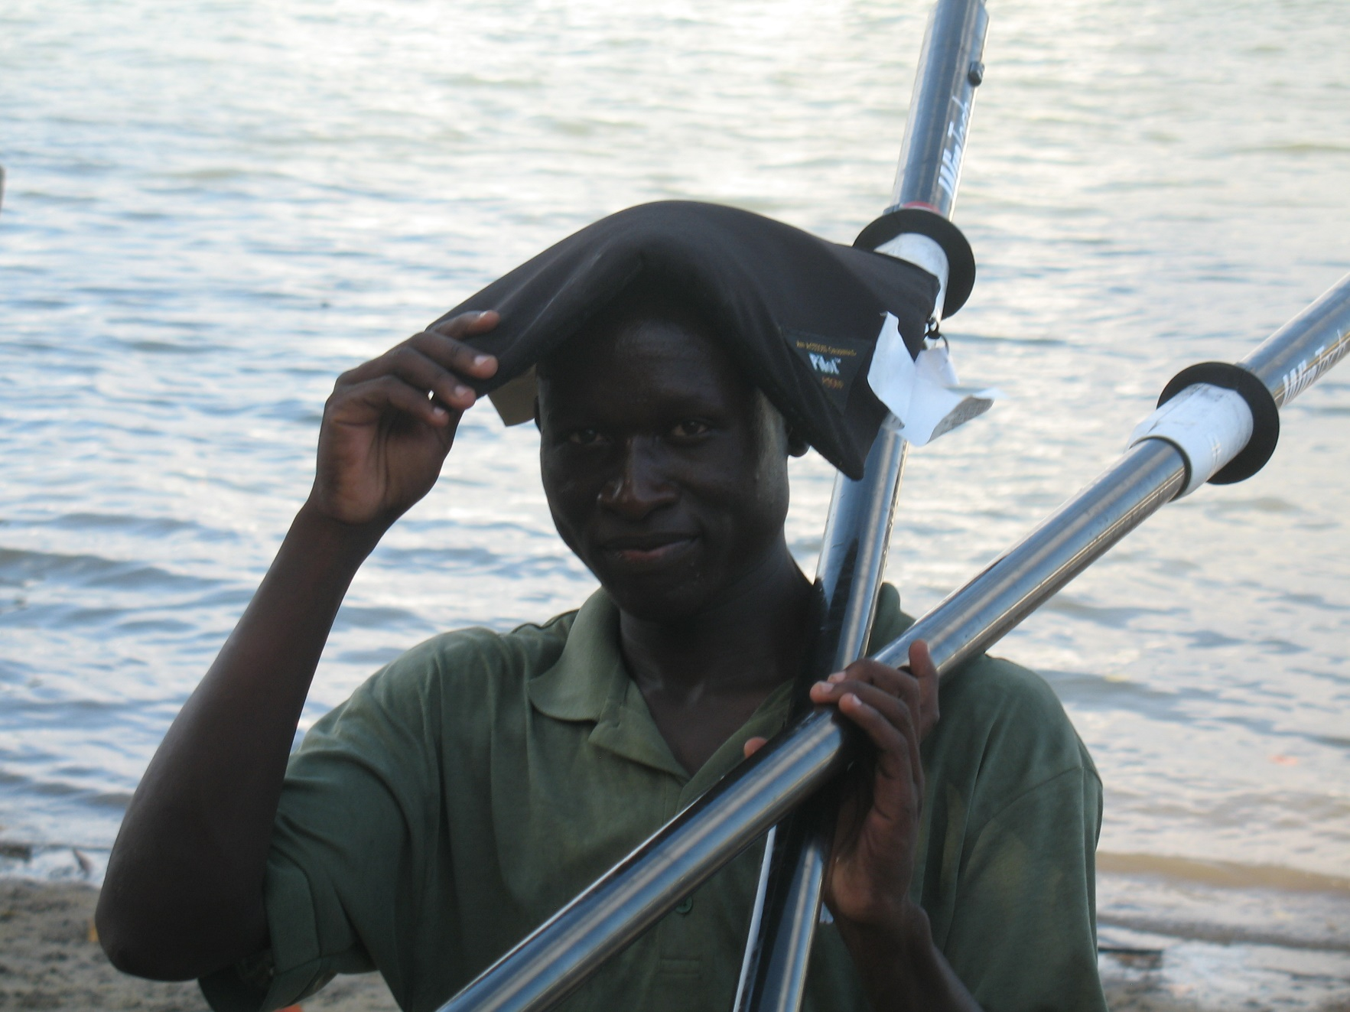

Slide 3


Inclusive Rowing Provision
There are four key elements to the delivery of Inclusive Rowing Provision
Consultation
Communication
Coaching
Club Administration
Notes:
It is important for everyone in a rowing club to adopt a positive attitude towards the inclusion of individuals with a disability that will help avoid creating barriers to participation. This often requires more thought than addressing the physical barriers and will be essential to the success of a club’s inclusive policy and practice.
There are four key elements to the delivery of inclusive rowing practice:
Consultation
Communication
Coaching
Club Administration
Consultation – Individuals with a disability often know how best to address issues of communication. It is important to consult before making assumptions on any key club strategy. Consultation will enable a club to determine the best practices for recruiting and developing an adaptive rowing programme.
Communication – Club information given in the form of notice boards, newsletters etc, should be made available to club members in a sensory format that is appropriate to their needs, which is not expensive, such as large print; Braille, audiotape, and/or language appropriate.
Coaching – when a club has members with a disability it is important for coaches to have some disability awareness training.
When possible, try to include members with a disability and involve them in coaching.
Club Administration – The majority of rowing clubs have an administrative structure managed by its members. Individuals with a disability should be encouraged and enabled to contribute to club administration through its various committees. In this way they can be consulted on all areas of the clubs functioning, be part of the decision making process, take on responsibilities and generally make a contribution to the club’s organisation.
Depending on the needs of the individual, this will require giving thought to how these committees function so that they can contribute fully. This may mean ensuring that meetings are held in a room that is physically accessible (appropriate to a wheelchair user needs). If the person has a visual impairment this may mean presenting minutes in braille/audiotape. If the person has a hearing impairment, ensure that there is an interpreter who can use appropriate sign language.
If the club has members with a learning disability, consider appointing an enabler, who will help them to understand both the procedures of meetings and the content of an agenda.

Slide 4

Barriers to Participation
Lack of early experiences in sport
Lack of understanding and awareness of how to include people with a disability in sport
Limited opportunities and programmes for participation, training and competition
Lack of accessible facilities, such as safe access to water and training facilities
Limited accessible transportation
Limiting psychological and sociological factors including attitudes towards disability of parents, coaches, teachers and even people with disabilities themselves
Limited access to information and resources
Notes:
Barriers to Participation
On an individual level, people with a disability may face a number of additional barriers
to participation in sport compared with people without a disability. Some common
barriers include:
• Lack of early experiences in sport (this varies between individuals and whether a
disability is from birth (congenital) or acquired later in life
• Lack of understanding and awareness of how to include people with a disability
in sport
• Limited opportunities and programmes for participation, training and competition
• Lack of accessible facilities, such as safe access to water and training facilities
• Limited accessible transportation
• Limiting psychological and sociological factors including attitudes towards
disability of parents, coaches, teachers and even people with disabilities
themselves
• Limited access to information and resources

Slide 5
Development Plan/Strategy
Objectives for programme
Recruitment Strategy
Budget
Local Partners
Strategic Partners
Coaching Resources
Notes:
Developing a Plan
In establishing any new program, the first step is to develop a plan to implement it. The plan should be prepared with as much consultation with the club membership as possible. There is sometimes a tendency, which varies from club to club, for established members to resent the presence of those learning to row. They tie up equipment and are frequently blamed for damaging equipment.
A club environment can be quite intimidating for any new member and established members need to go out of their way to make them feel welcome. Prior to establishing a Para-Rowing program, the club membership needs to know the implications of running such a program, be requested to provide support and, at the same time, should be instructed on how to make participants feel at home.
The plan should identify the committee or individual (i.e. the ‘champion’) who will take responsibility and include a time table for implementation, a recruiting strategy, a budget and sources of funding, coaching and volunteer resources, timing for introductory and orientation sessions, designated training times, provisions for transportation and measurable objectives for the program.

Slide 6
Considerations
Start Small
Define limitations (see access audit)
Programme Structure (adapt learn-to-row programme)
Equipment Resources (standard/adaptive)
Programme Dates/Times
Community/Local Support
Grants for Equipment
Sponsors
Notes:
Do’s and Don’ts
Just as each club offers different variations of programs, adaptive rowing can vary in scope, availability and structure from one club to another.
Start small. Don’t try to be too ambitious. Two to four participants is a good start. It is better to focus on providing a quality experience for the participants than going for numbers. The success of your first session will allow your program to grow over time. Keep the number of participants manageable until you have developed the volunteer base and you know that your program can accommodate more people.
Determine what limitations your club situation presents. (see access audit)
Is your club wheelchair accessible? Many clubs have steep ramps down to the boat docks that cannot be negotiated by people with limited mobility. Can these limitations be overcome? Can you support all disabilities, or will you limit your offering, for example, to participants who are visually impaired or hearing impaired? The answer to these questions will determine how you will undertake recruitment and which community organisations you will contact.
Outline the structure of your program. There is no need to create an entirely new approach for your program. Consider modeling your program on your current learn-to-row structure. It is always a good idea to define the program duration, e.g. 8 sessions. As in the Learn to Row program, you will need to provide options for people to stay involved in the sport after the introductory program. You will want to determine your volunteer/participant ratio and to consider having experienced rowers in the boat for safety and stability during the initial sessions. You can also encourage participants to bring a relative or friend with them.
Identifying Equipment. Identify what equipment you have available for your program. Do you have a dock-side trainer or ergometer available? These provide a very good transition from orientation to going on the water.
Depending on the range of participants, fixed or special seats may be needed. Recreational boats work best for initial training. A recreational double works very well since it allows a volunteer to accompany the Para-Rower and provide coaching and support.
Determine the budget. This does not have to be substantial, but you may want to consider honorariums for your volunteers or coordinator to encourage commitment to the program, as well as any equipment or items you may need (inflatable PFDs, posture seats, t-shirts, etc.). You can use this budget along with your program outline to apply for grants from various sources (your city or municipality, physically disabled support organizations, service clubs, etc). You may also want to consider a fund-raising initiative specifically for this program.
Set the dates of your program. Set the dates for your program well in advance and recruit volunteers within your membership. Actively engage the volunteers in planning the sessions and in recruiting participants.
Contact community or support organisations in your area to develop partnerships and to see what funding or assistance may be available to your program. Consider adding an announcement of your program to newsletters offered by support organisations, including NPC’s and disability charities.
Some community living groups may be interested in setting up a joint program to benefit their clients specifically. This kind of arrangement can reduce the amount of time you need to spend on ‘getting the word out’. In addition, some of these organizations can provide staff personnel to assist.

Slide 7
Benefits to the Individual
Statistics show that people with disabilities are far less likely to take part in regular sport or physical activity than their non-disabled peers. But individuals with a disability have so much to gain from regular physical activity:
Risk of Cardiovascular Disease
Over-Use Injuries
Diabetes
Obesity
High Blood Pressure
Disuse Osteoporosis
Blood Lipid Disorders
Depression and Anxiety
Notes:
Benefits to the Individual
Statistics show that people with disabilities are far less likely to take part in regular sport or physical activity than their non-disabled peers. But individuals with a disability have so much to gain from regular physical activity. It can help to minimise issues experienced in day-to-day life, including overuse injuries in wheelchair propulsion. Further to this Para-Rowing for some individuals addresses the secondary health consequences as a result of leading a sedentary lifestyle, including:
Risk of cardiovascular diseases
Diabetes
Obesity
High blood pressure
Disuse osteoporosis
Blood lipid disorders
Depression and anxiety
In addition, by doing regular rowing activity, you will sleep better, have more energy, and feel better about yourself. The benefits of exercise go far beyond physical health and the confidence gained can often spill over into other areas of your life.
So, whatever your disability, it is important to find a way to overcome these initial obstacles as taking part in a sport like rowing is vital for everyone. Fortunately, there are more and more facilities that now pride themselves on being disability friendly, especially if you are willing to be flexible and come with an open mind.

Slide 8
Benefits to a Club
Strengthening of community involvement by being able to offer rowing to all members of your surrounding population
Increased membership base and overall program offering
Enhancement of club pride and reputation
Media attention
Potential funding streams
Shared Equipment
Notes:
Benefits to Your Club
No matter what the scope or size of your adaptive program, it will quickly become clear that this program can positively add to many aspects of your club.
Some of the clear benefits your club can enjoy including:
Strengthening of community involvement by being able to offer rowing to all
members of your surrounding population
Increased membership base and overall program offering
Enhancement of club pride and reputation
Media attention which will generate interest in all of your club programs and will
benefit your club as a whole
Increased fundraising abilities resulting in cash or equipment donations. Many charitable foundations need you to demonstrate fully inclusive programs before being considered eligible for grants.
Equipment for your Para-Rowing program can be shared with other programs when not reserved by adaptive rowers, increasing your club’s overall inventory. The equipment used is ideal for all learn-to-row programs and for touring.
Identify possible elements from information in workshop that could be used to develop your own club Para-Rowing program.

Slide 9
Global Development Challenges
A shortage of physical education and ‘sport for all programmes’
A lack of financing for sport
A lack of sport facilities and limited equipment
Limited capacity to host major sporting events with the result that developing countries have fewer medal performances than developed countries
Developing countries also face a range of social and cultural barriers that impact on sport participation including: religion, culture, language
With international sports including Para-Rowing, there is a widening gap between developed and developing countries. This gap has been linked to:
Notes:
Developing Countries
In international sports including Para-Rowing there is a widening
gap between developed and developing countries. This gap has been linked to a
shortage of physical education and ‘sport for all programmes’, a lack of financing for
sport, few sport facilities and limited equipment, and no capacity to host major sporting events with the result that developing countries have fewer medal performances than developed countries.
Developing countries also face a range of social and cultural barriers that impact on sport participation including: religion, culture, language, and the lingering influence of colonialism in many parts of the world.
There is limited research that explores the specific barriers to participation in sport for
people with a disability in developing countries. Much more evidence is needed along
with financial support to ensure that people with a disability have both the opportunity
and the choice to participate in Para-Rowing regardless of which country they live in.

Slide 10
FISA Para-Rowing Continental Outreach Programme
The project will deliver the following:
Organised training camps in 2019 on each continent (Africa, Asia, Americas, Europe and Oceania) to identify and select athletes and train coaches to prepare for the Continent Paralympic Qualification Regattas
Deliver Educational workshops at each training camp and follow up to train coaches and administrators about setting up and developing a Para- Rowing program
Send ‘FISA experts’ to deliver these workshops, but also make site visits to some countries to support with creating and implementing a strategy and plan of action
Notes:
The amount of member federations engaged in para rowing has increased in the last several years, but most of it is still centered in Europe. In order to grow the sport globally a continental approach is needed to distribute knowledge, resources and equipment to give nations the tools to build their para rowing programs.
FISA has decided for the 2016 – 2020 Paralympic cycle to stage Continental Paralympic Qualification Regattas. In the lead up to these regattas, training camps and workshops are organised that will enable the hosting nations in each continent to get boats, equipment and train people in order to establish a para rowing structure which can service the region.
FISA is currently developing para rowing resources and modules which will be integrated with the existing Educational Framework. The goal is that every coaches course will have a para rowing component. All rowing coaches will get introduced and educated about para rowing and be able to train para rowers.
This project seeks to deliver these training camps and educational workshops to train coaches and administrators on each continent to be able to (further) develop para rowing in their respective nations. FISA used this continental approach for growing their Olympic rowing representation going from 75-member federations at the beginning of 2000 to 154-member federations now.

Slide 11
FISA Para-Rowing Continental Outreach Programme
Project Impact:
Develop Para-Rowing programs in 15-20 nations
Africa 3, Americas 5, Asia 3, Europe 5, Oceania 2
Train 80 – 100 para rowing coaches (20 on each continent)
Increase the amount of athletes in the PR1 and PR2 class (high support athletes) by 200 athletes, especially female athletes
Leave a legacy with functional para rowing structure on each continent Coaches: more coaches to be trained in para rowing on each continent. All coaches to learn the basics about Para-Rowing
Improve NF’s, NPC’s knowledge about para-rowing which is currently non-existent or limited
Notes:
Expected impact is:
develop para rowing programs in 15-20 nations (Africa 3, Americas 5, Asia 3, Europe 5, Oceania 2)
train 80 – 100 para rowing coaches (20 on each continent)
increase the amount of athletes in the PR1 and PR2 class (high support athletes) by 200 athletes, especially female athletes
leave a legacy with functional para rowing structure on each continent which can organise workshops, regattas and distribute equipment to the region on demand
Coaches: more coaches to be trained in para rowing on each continent. All coaches to learn the basics about para rowing.
Athletes (general): grassroots participants needed to grow a pool for recreation and competition. At competition level focus on high support athletes (PR1 and PR2) and women. In para rowing most of the events are mixed boats. There are currently enough men on a competitive level, but not yet enough women who participate at this level.
High support athletes: the current structure allows for PR3 athletes to use standard Olympic hull boats to train and compete in. These boats are available in most countries. PR1 and PR2 athletes use specialised para rowing boats. These need to be distributed in each continent to enable these high support athletes to train and compete in international competition standard boats.
Administrators: knowledge about para-rowing is currently non-existent or limited
NFs: knowledge about para-rowing is currently non-existent or limited
NOCs and NPCs: knowledge about para-rowing is currently non-existent or limited

Slide 12
Further Reading
http://www.worldrowing.com/mm//Document/General/General/13/08/49/2018WR-Strategicframeworkv3(002)_English.pdf
https://www.paralympic.org/the-ipc
http://globalsportsdevelopment.org

Slide 13
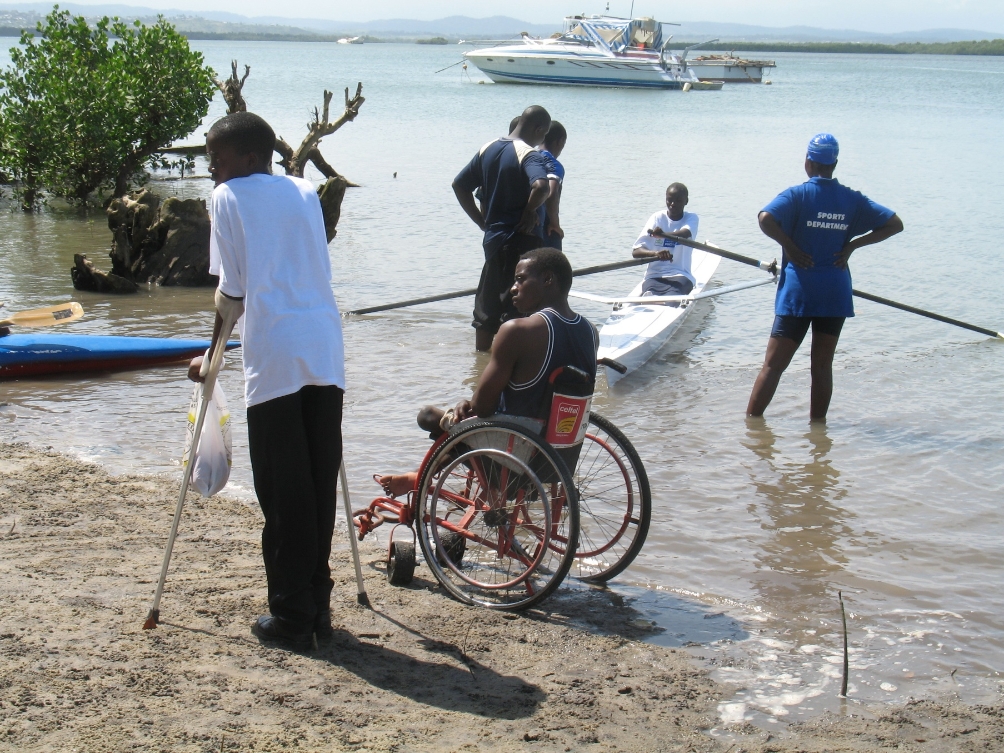

Slide 14
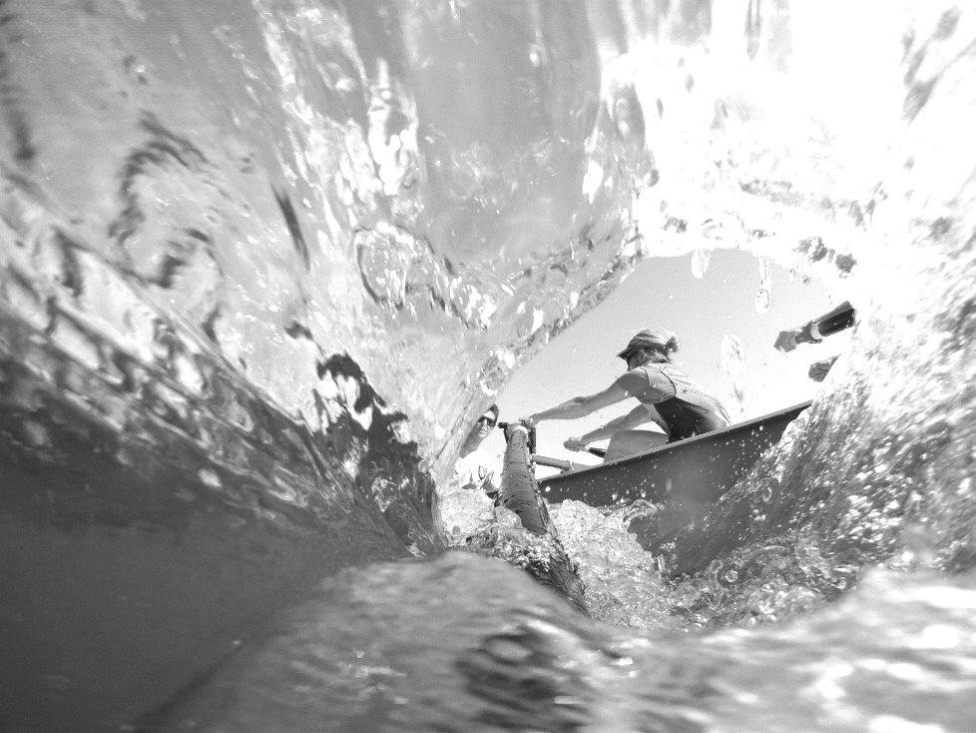

Thank you !
Thank you!

