Slide 1

People First Language
September 2019
Notes:
People-first language is a type of linguistic prescription in English. It aims to avoid perceived and subconscious dehumanisation when discussing people with disabilities and is sometimes referred to as a type of disability etiquette.
People-first language can also be applied to any group that is defined by a condition rather than as a people: for example, "those that are homeless" rather than "the homeless".
Rather than using labels to define individuals with a health issue, it is more appropriate to use terminology, which describes individuals as being diagnosed with an illness or disorder. People first language puts the person before the diagnosis and describes what the person has not what the person is.
The basic idea is to use a sentence structure that names the person first and the condition second, for example, "people with disabilities" rather than "disabled people" or "disabled," in order to emphasise that "they are people first."

Slide 2
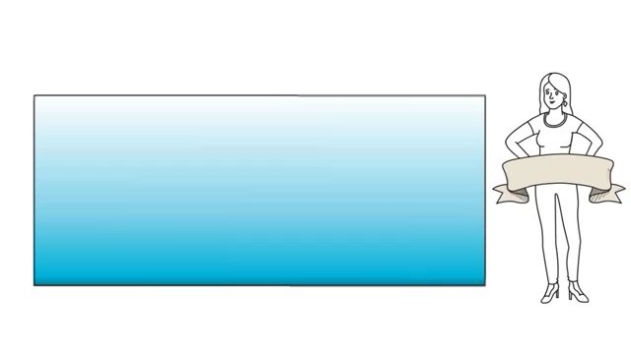
Defining Terminology – “People First Language”

Slide 3
People First Language | Labels that Stereotype
people/individuals with disabilities an adult who has a disability a child with a disability a person | the handicapped the disabled
people/individuals without disabilities typical kids | normal people/healthy individuals atypical kids
people with intellectual and developmental disabilities he/she has a cognitive impairment a person who has Down syndrome | the mentally retarded; retarded people he/she is retarded; the retarded he/she's a Downs kid; a Mongoloid; a Mongol
a person who has autism | autistic
people with a mental illness a person who has an emotional disability with a psychiatric illness/disability | the mentally ill; the emotionally disturbed is insane; crazy; demented; psycho a maniac; lunatic
a person who has a learning disability | he/she is learning disabled
a person who is deaf he/she has a hearing impairment/loss a man/woman who is hard of hearing | the deaf
person who is deaf and cannot speak who has a speech disorder uses a communication device uses synthetic speech | is deaf and dumb mute
a person who is blind a person who has a visual impairment man/woman who has low vision | the blind
a person who has epilepsy people with a seizure disorder | an epileptic a victim of epilepsy
a person who uses a wheelchair people who have a mobility impairment a person who walks with crutches | a person who is wheelchair bound a person who is confined to a wheelchair a cripple
a person who has quadriplegia people with paraplegia | a quadriplegic the paraplegic
he/she is of small or short stature | a dwarf or midget
he/she has a congenital disability | he/she has a birth defect
Notes:
When referring to a person with a disability, their name or a pronoun should come first followed by a description of their disability. It is important to identify the impairment, but not imply it has ‘modified’ the person, thus providing guidance on which terms to use and which are inappropriate. See the table below for examples.
The social model of disability means that whilst someone's impairment (e.g. a spinal cord injury) is an individual property, ‘disability’ is something created by external factors such as a lack of wheelchair access to their rowing club. ‘People First Language’ recognises that individuals with disabilities are people first and foremost. It emphasises each person's value, individuality, dignity and capabilities.

Slide 4
Examples in Para-Rowing
Negative People First Language
Disabled Rower alternative Rower with a Disability
Blind Rower alternative Rower with a Visual Impairment
Deaf Rower alternative Rower with a Hearing Impairment
Paraplegic Rower alternative Rower with Paraplegia
Disabled Rowing Club alternative Adaptive/Para-Rowing Club
Disabled Boat alternative Adaptive/Para Boat

Slide 5


Thank you !
Thank you!

