Slide 1
GOVERNANCE
CONGRESS
156 Member Federations
Council
(24 members)
Executive Committee
(8 members)
Delegates
from the
13 Member
National Federations
15 Elected Members
8 Appointed
Members
World Rowing Office
January 2022

Slide 2
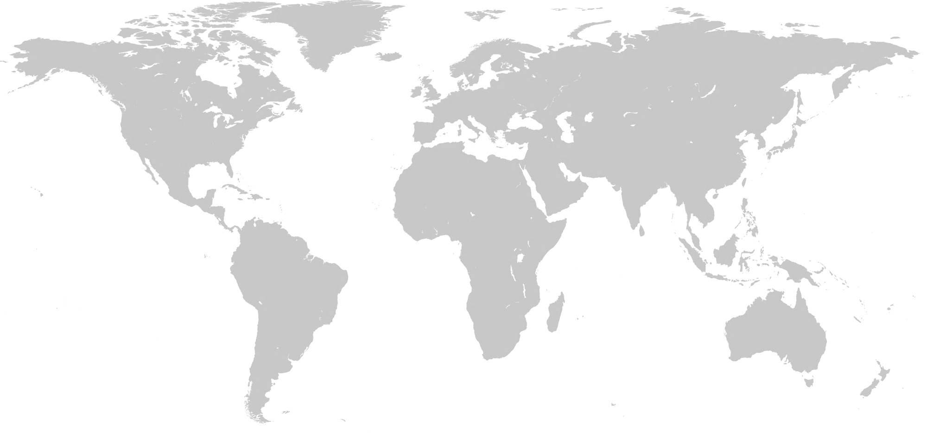
GOVERNANCE
Member Federations by Continent
37
46
31
34
8
156 Members
January 2022

Slide 3
GOVERNANCE
World Rowing Council
Executive Director
Vincent Gaillard
(SUI)
Vice President
Tricia Smith
(CAN)
Treasurer
Gerritjan Eggenkamp
(NED)
FISA President, Jean-Christophe Rolland (FRA)
Officers
Commission Chairs
Co-opted Members
Continental Representatives
Delegates
from the
13 Member
National Federations
Discipline Commissions:
Coastal Rowing – Guin Batten (GBR)
Competitive Rowing – Rosie Mayglothling (GBR)
Indoor Rowing – Filip Ljubicic (SRB)
Technical Commissions:
Athletes – Frida Svensson (SWE)
Equipment & Technology – Paul Fuchs (USA)
Events – Eva Szanto (HUN)
Gender Equality Diversity & Inclusion - Jacomine Ravensbergen (NED)
Masters Rowing - Ron Chen (USA)
Para Rowing – Rebecca Orr (CAN)
Sports Medicine – Jürgen Steinacker (GER)
Umpiring - Patrick Rombaut (BEL)
Youth Rowing – Algirdas Raslanas (LTU)
Council Member, Sustainability – Pat Lambert (BEL)
Africa - Mehdi Garidi (ALG)
Americas - Victoria Aguirregomezcorta (ARG)
Asia – Fay Ho (HKG)
Europe - VACANT
Oceania – VACANT
15 Elected Members
8 Appointed
Members
Masakuni Hosobuchi (JPN)
Lenka Dienstbach-Wech (GER)
January 2022

Slide 4
GOVERNANCE
World Rowing Executive Committee
World Rowing President, Jean-Christophe Rolland (FRA)
Vice President, Tricia Smith (CAN)
Treasurer, Gerritjan Eggenkamp (NED)
Executive Director, Vincent Gaillard (SUI)
Commission Chair, Eva Szanto (HUN)
Commission Chair, Patrick Rombaut (BEL)
Commission Chair, Rosie Mayglothling (GBR)
Athlete’s Commission Chair, Frida Svensson (SWE)
Delegates
from the
13 Member
National Federations
15 Elected Members
8 Appointed
Members
January 2022

