Slide 1


2021 Virtual
Virtual| December 2021

Slide 2

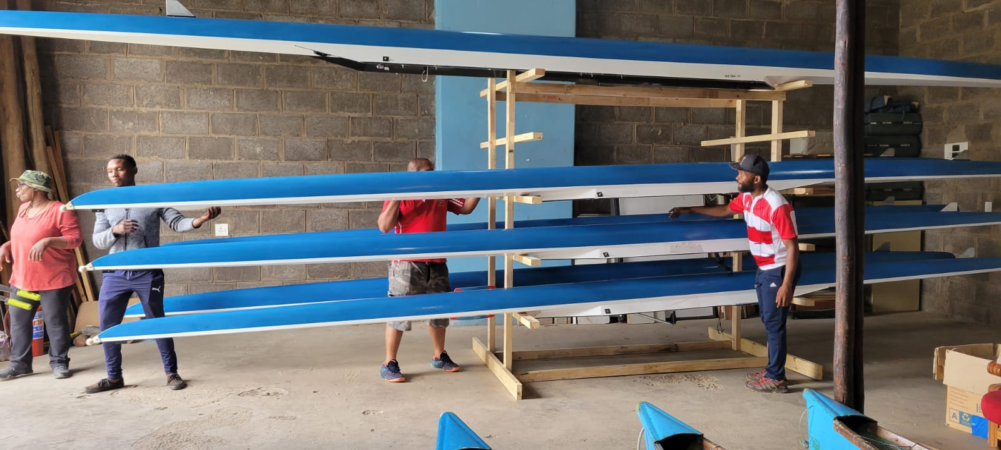
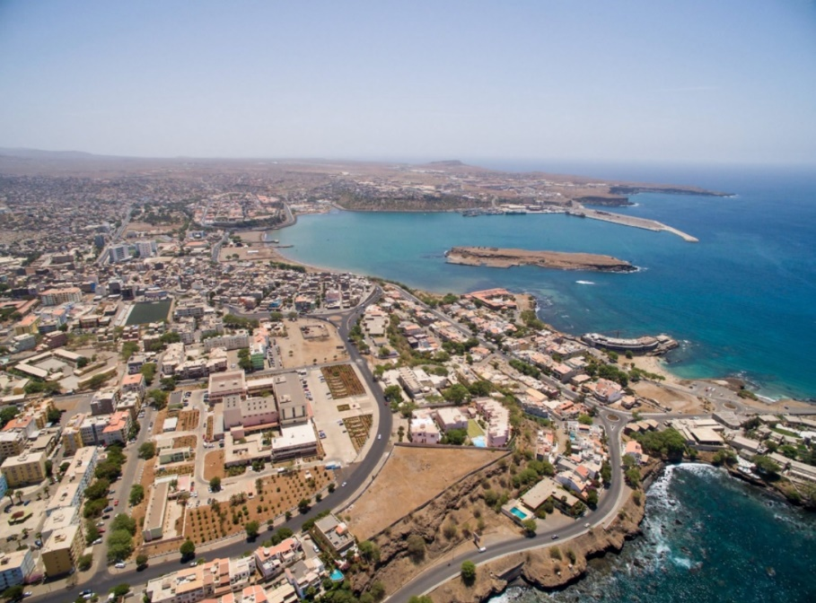
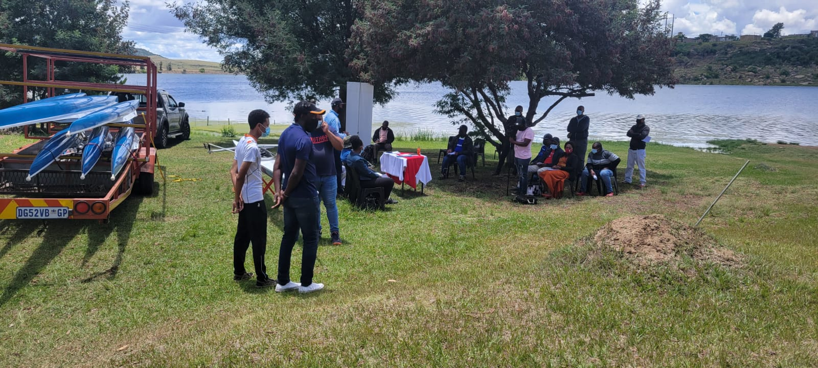

2021 Report of the AFRICA Continental Rep
2021 Primary Achievements
National Development Activities
Lesotho, site visit and boat donation, November 2021, by Sizwe Ndlovu
Cape Verde, Coastal L1, 17-23rd December, by Rui Faria

Slide 3
2021 Report of the AFRICA Continental Rep
2021 Primary Achievements
Continental and regional Activities
Training camp in Tunisia for qualified nations to the Olympic Games, May - June 2021 LBA, NGR, TOG through athlete scholarships

Slide 4
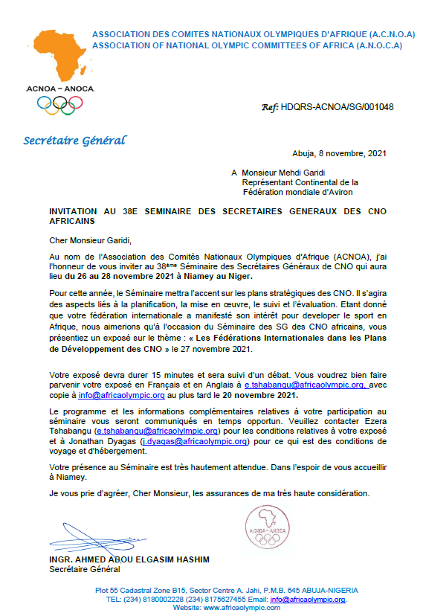
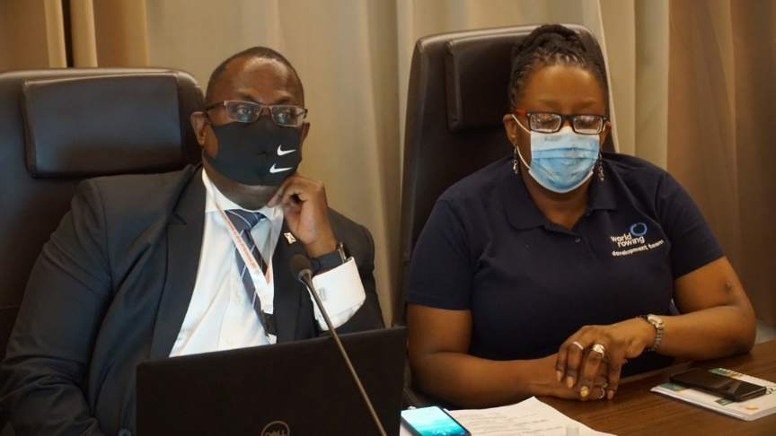
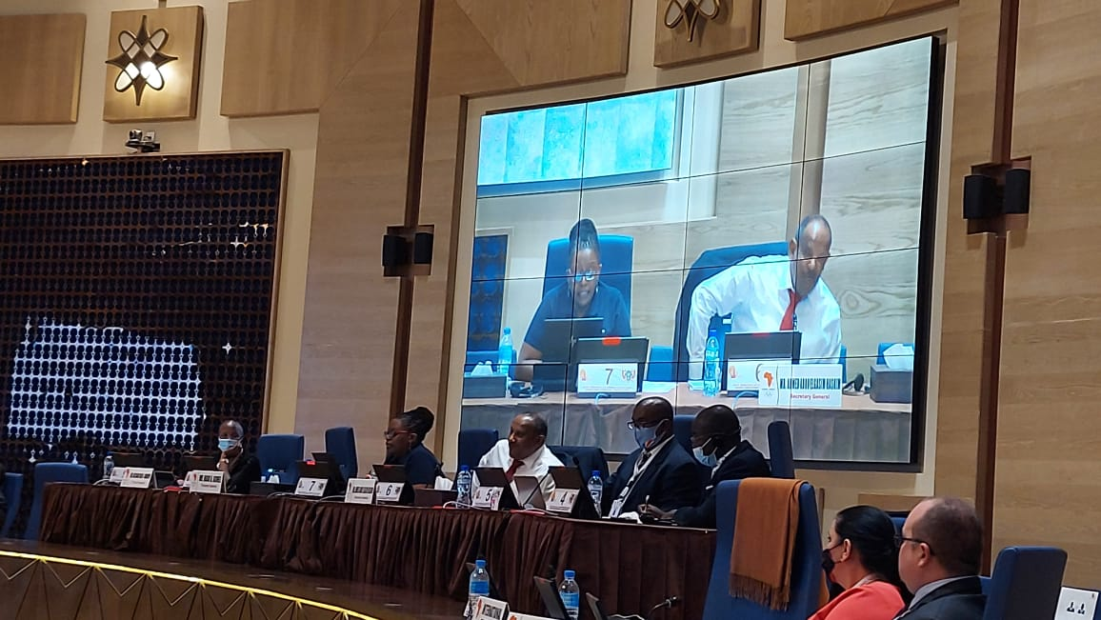
2021 Report of the AFRICA Continental Rep
2021 Primary Achievements
Continental and regional Activities
2. ANOCA - NOC SG’s meeting Niger 26-27th November 2021 attended by Anna Mguni, rowing was one of the only 3 sports invited to make a presentation, with Teqball and Sailing

Slide 5
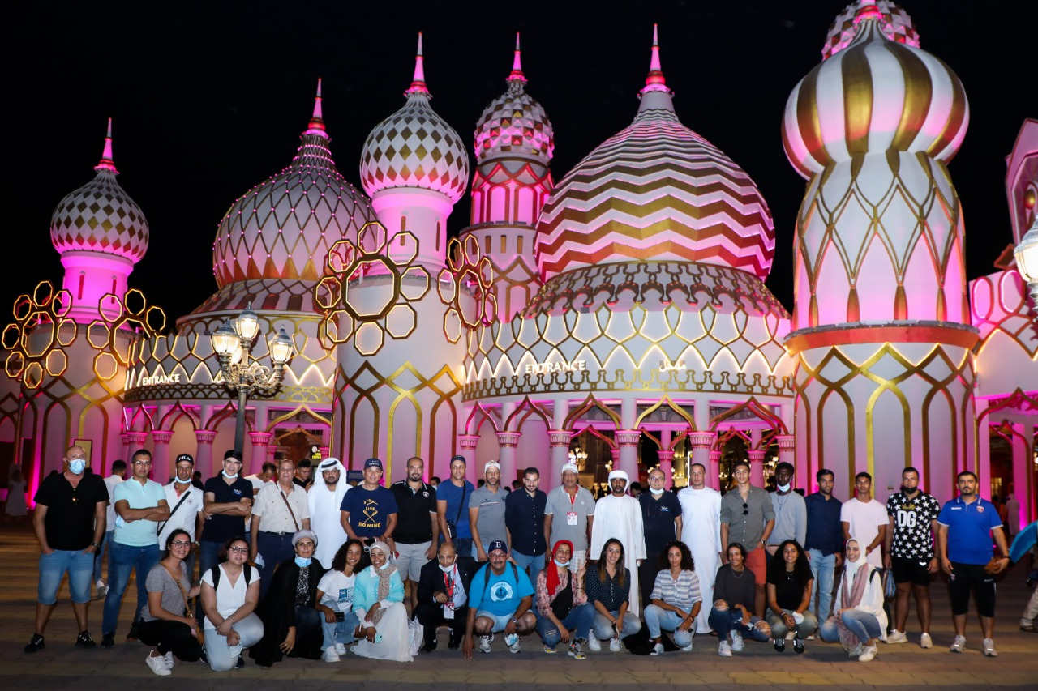
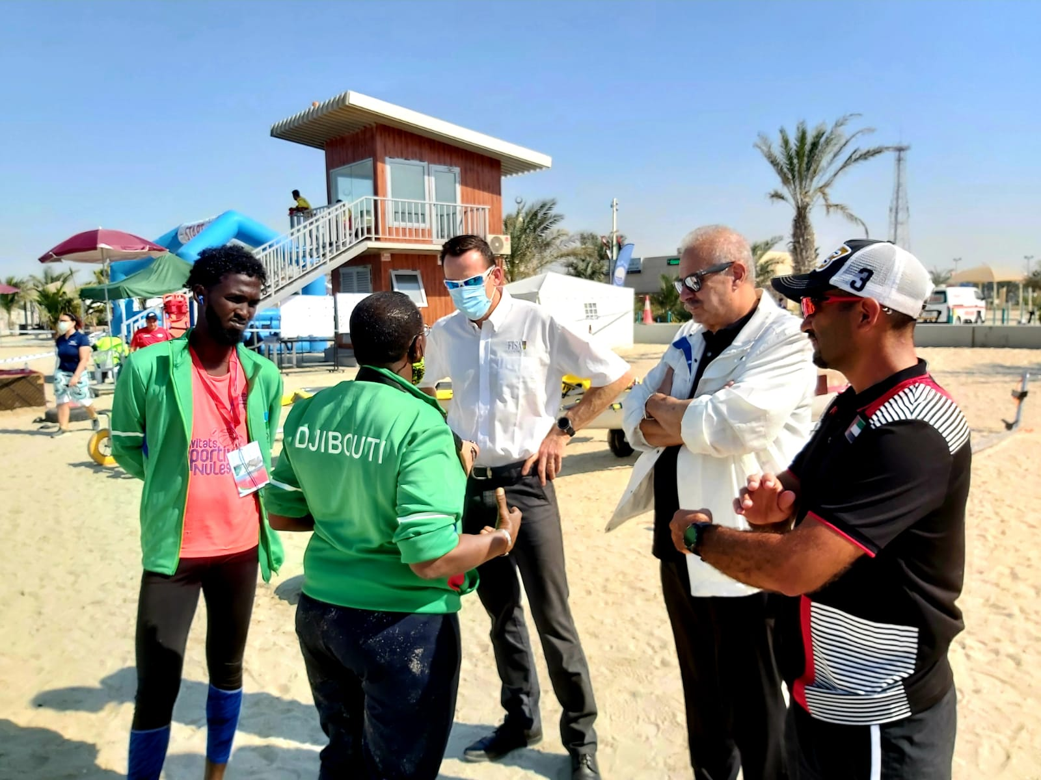
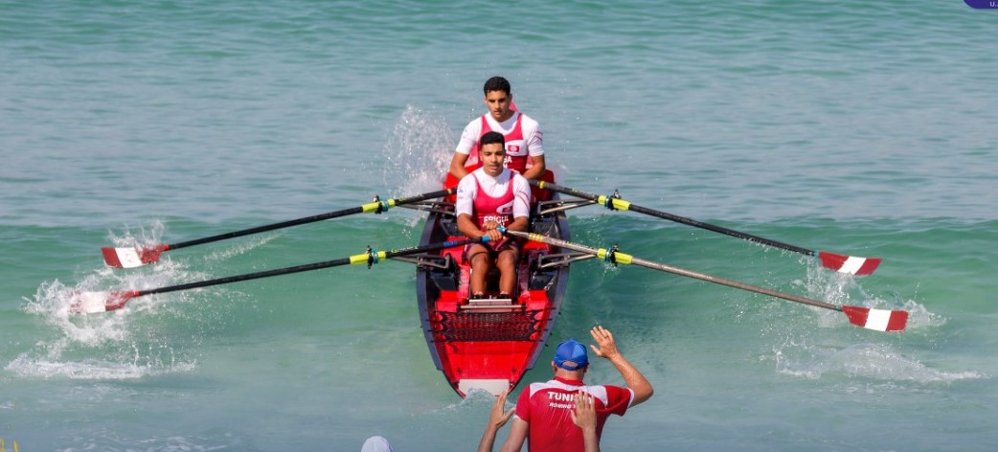
2021 Report of the AFRICA Continental Rep
2021 Primary Achievements
Continental and regional Activities
3. Arab beach Sprint Championships, UAE- assistance and guided coaching sessions for participating countries (07 African nations) TUN, MAR, LBA, EGY, SUD, DJI, SOM, (32 athletes, 21 M, 11 F)

Slide 6
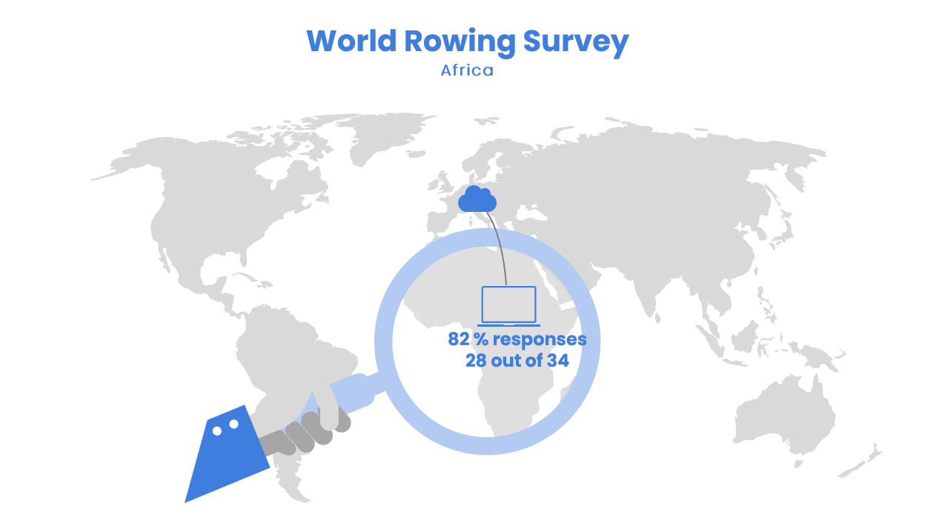
2021 Report of the AFRICA Continental Rep
2021 Primary Achievements
Continental and regional Activities
4. World Rowing Survey – 28/34 MF responded to the survey

Slide 7
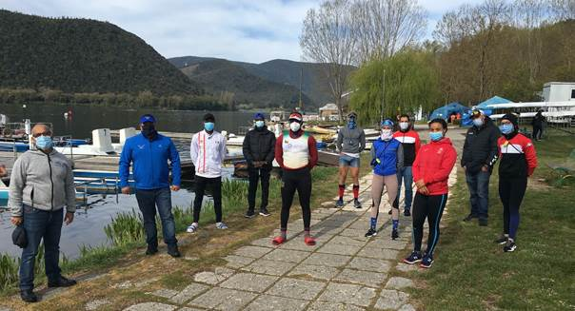
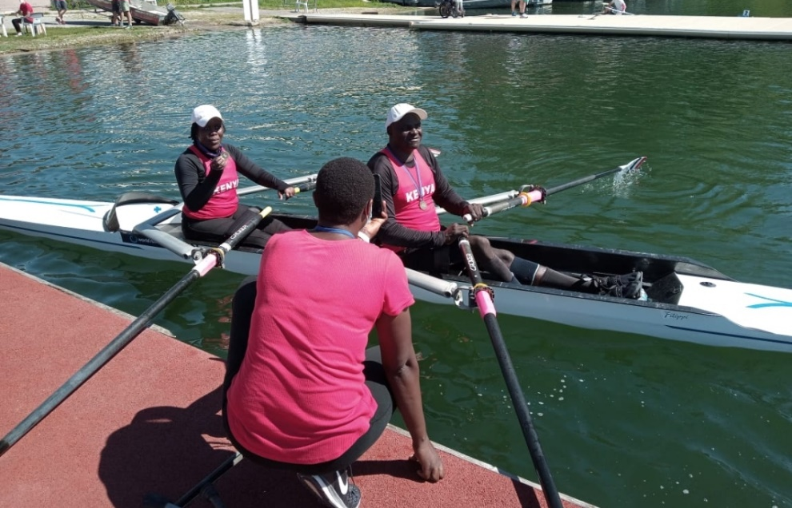
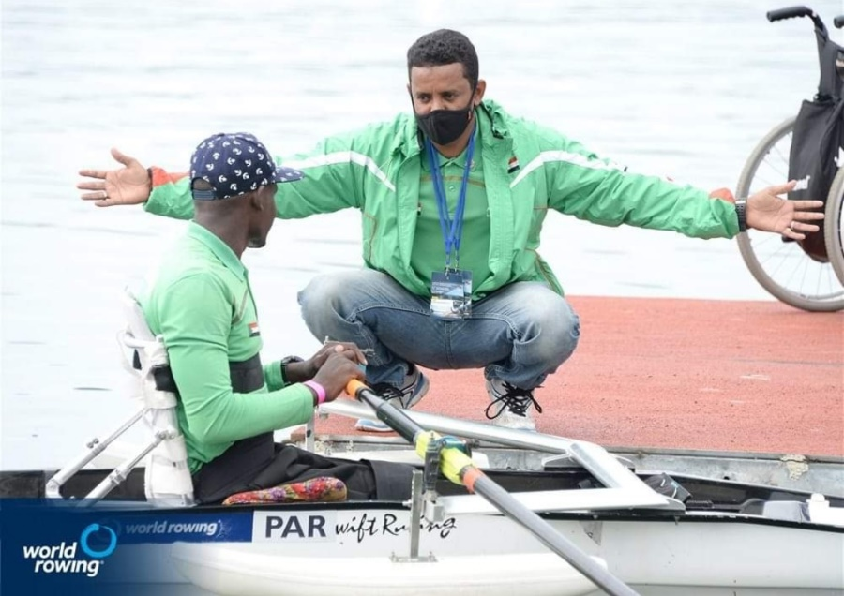
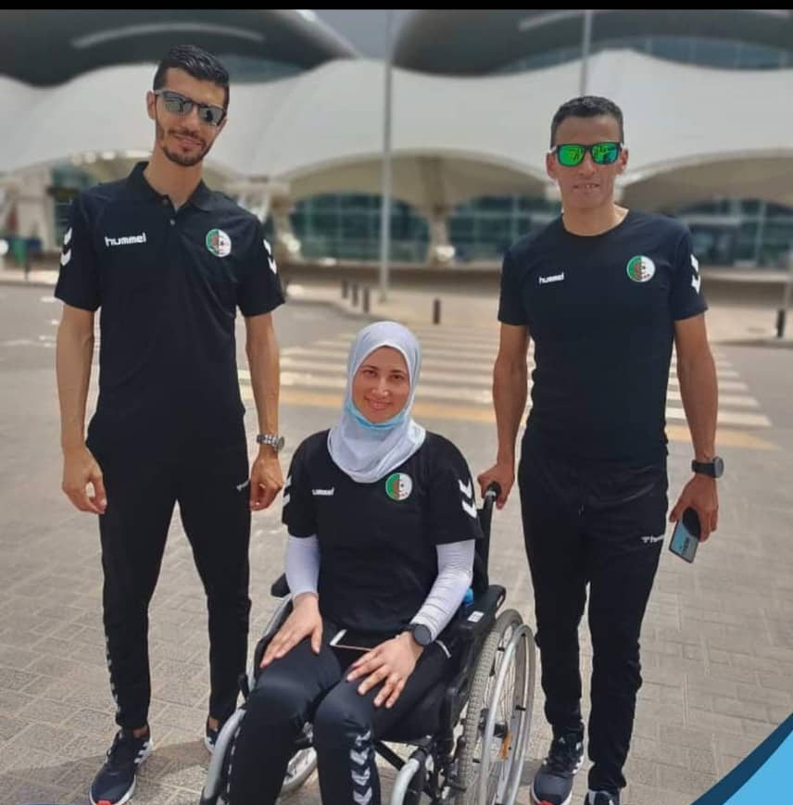
2021 Report of the AFRICA Continental Rep
2021 Primary Achievements
International Activities
1. Piediluco – Memorial Paolo d’Aloja, training camp for African nations: 6 countries participated
BEN, CIV, NAM, MAR, TUN, ZIM
(4 M, 4 F, 4 male coaches)
2. FPQR Gavirate - support to the participating development nations, 5 countries participated
ALG, SUD, KEN, CPV, NGR, 12 athletes (6 M, 6 F)

Slide 8
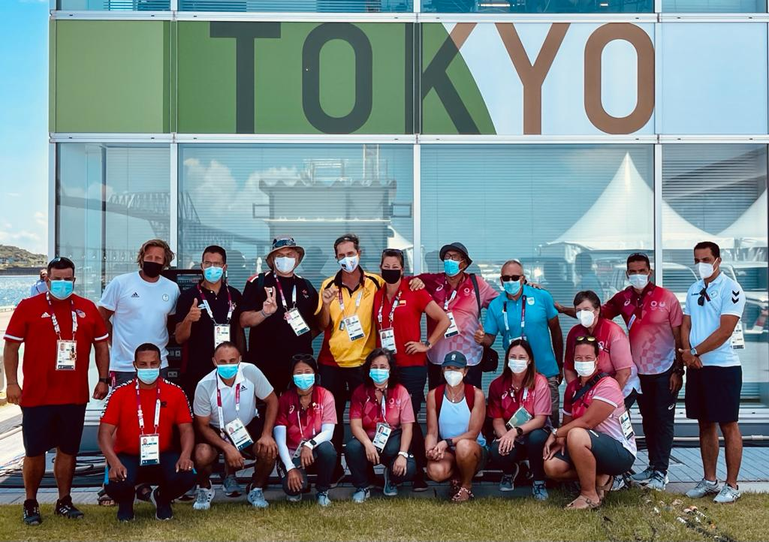
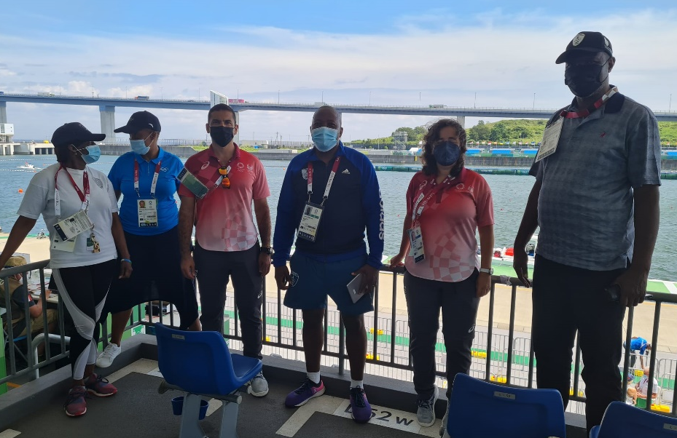
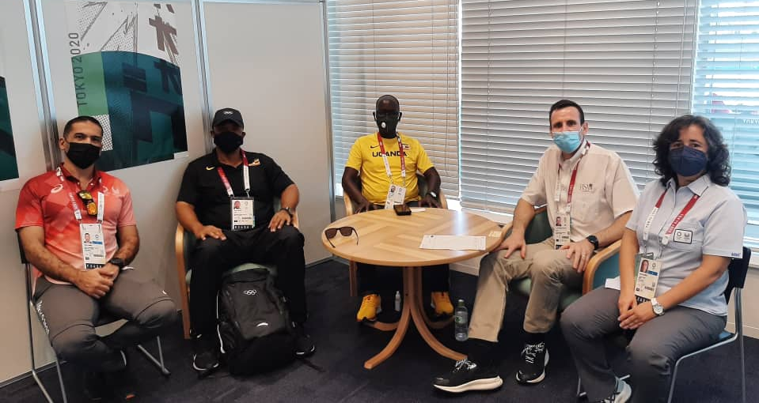
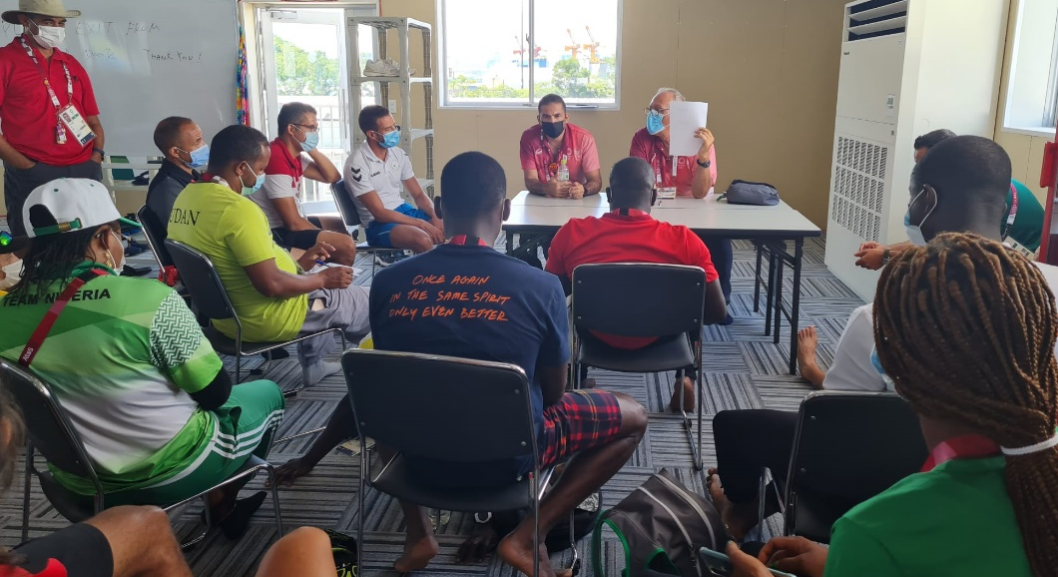
2021 Report of the AFRICA Continental Rep
2021 Primary Achievements
International Activities
3. Tokyo - Support to the participating development nations
4. Tokyo - meeting with NF’s, CNO’s and Sports Ministries representatives from TOG, UGA, EGY, SUD, NGR, LES, BEN

Slide 9
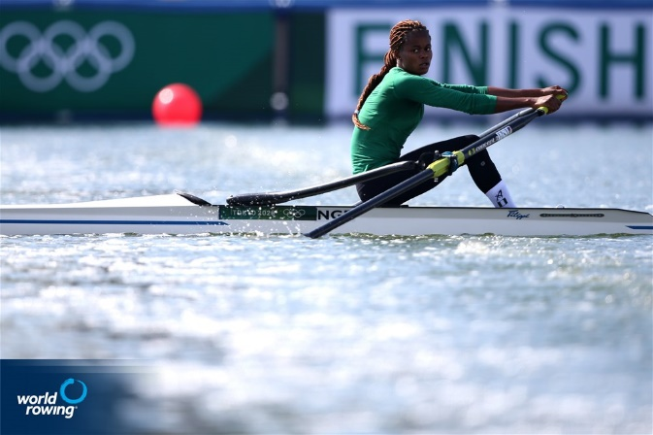
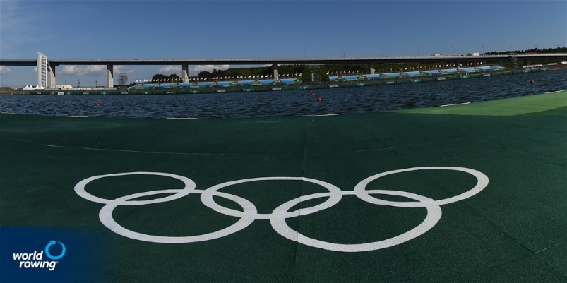
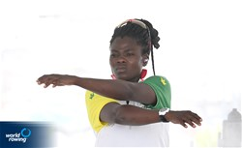
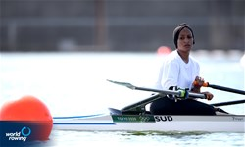
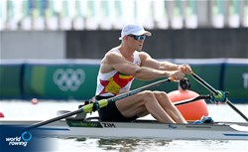
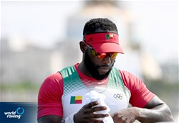
2021 Report of the AFRICA Continental Rep
2021 Primary Achievements
Rio 2016
9 NOCs from Africa Qualified
Tokyo 2020
15 NOCs from Africa Qualified

Slide 10
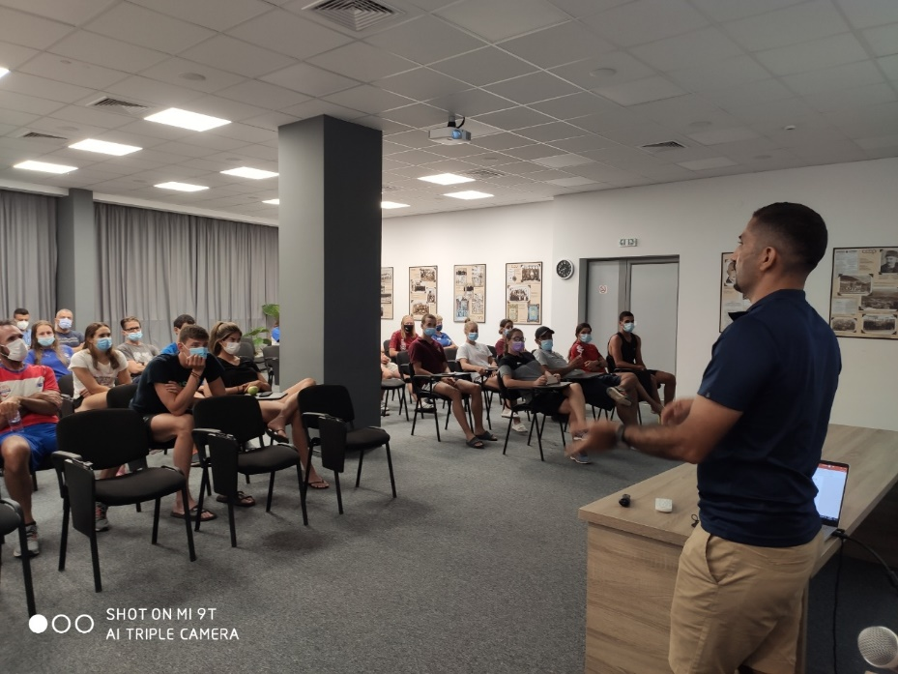
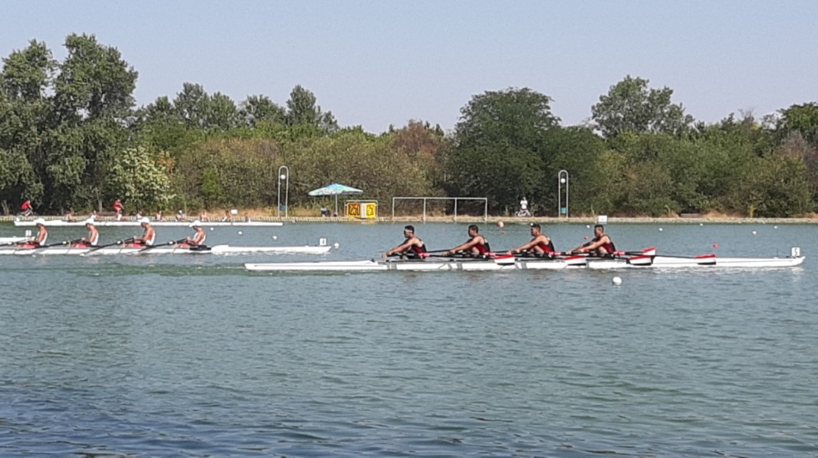
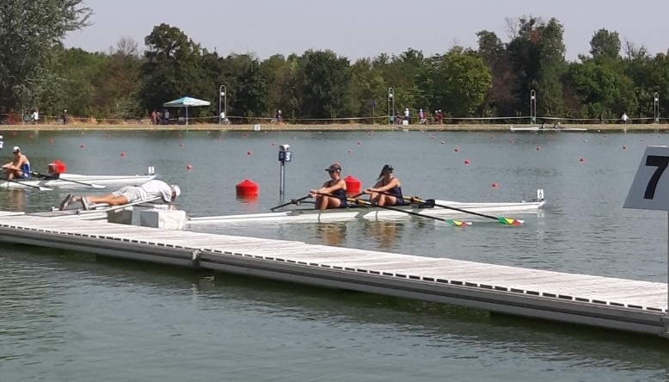
2021 Report of the AFRICA Continental Rep
2021 Primary Achievements
International Activities
5- WRU23CH- equipment and logistical support for developing nations, TUN, MAR, CIV
6- WRU19CH – support to developing nations, 3 Countries, TUN, ZIM, EGY, 11 athletes, (7 M, 4 F)

Slide 11
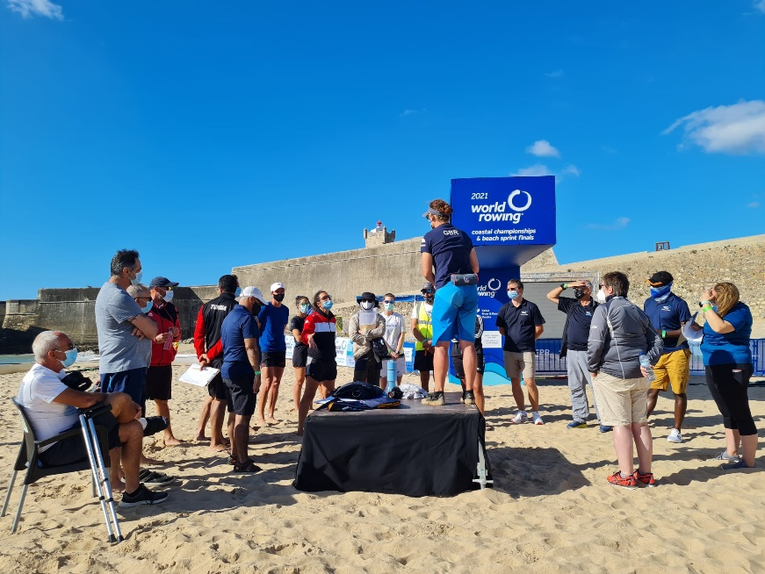
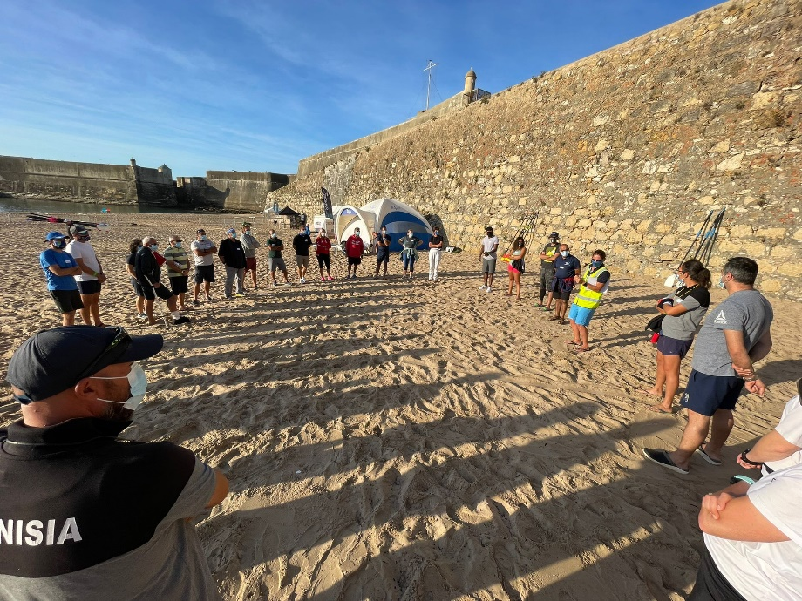
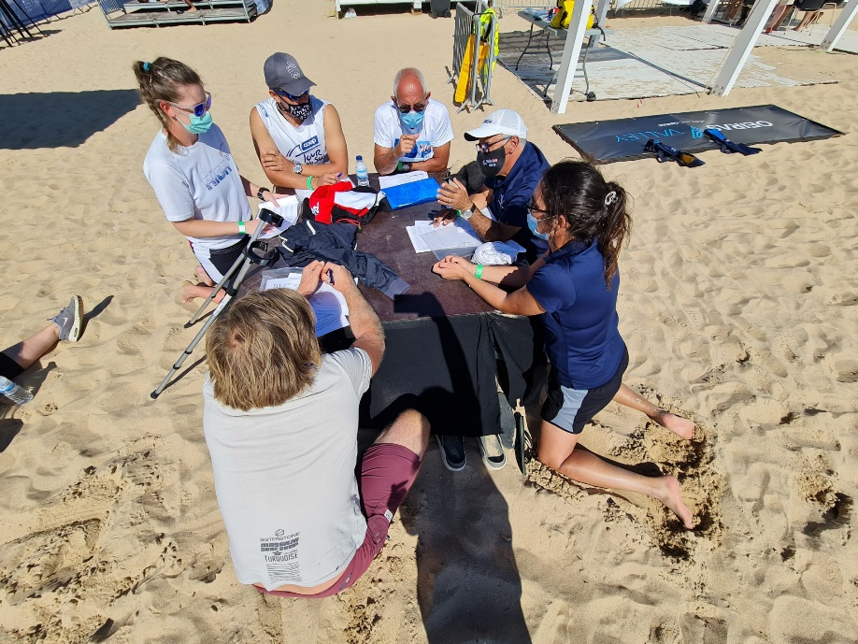
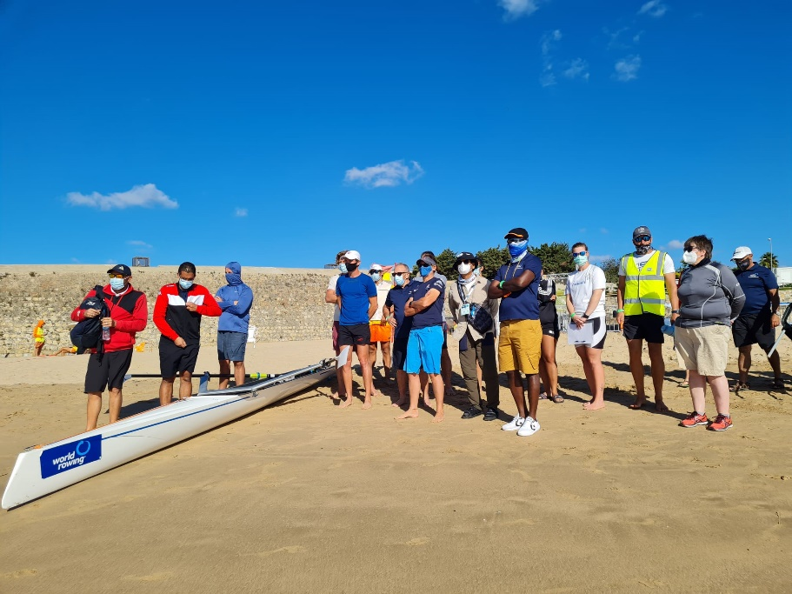
2021 Report of the AFRICA Continental Rep
2021 Primary Achievements
International Activities
7. Coastal Rowing Module Coach and Coach Educator training, virtual sessions + face2face course Portugal attended by 7 coaches from 4 countries TUN, EGY, ALG, RSA Sahbi, Chokri, Fayçal, Ibtissem, Mehdi, Emma, Sizwe,

Slide 12
2021 Report of the AFRICA Continental Rep
2021 Primary Achievements
Participation at the World Rowing events - Boats
 |  | WRIC | WRC1 | WRC2 | WRC3 | FOQR | FPQR | WU23CH | WRJCH | WRBSF | WRCC | OG | PG
 |  | 154 | 2 | 7 | 5 | 5 | 6 | 7 | 9 | 11 | 9 | 15 | 2 | 78
1 | TUN | 24 | 1 |  |  | 1 |  | 1 | 2 | 6 | 5 | 1 |  | 17
2 | EGY | 43 |  | 3 | 2 | 2 |  | 1 | 1 | 1 | 3 | 1 |  | 14
3 | RSA | 32 |  |  |  | 2 |  | 2 | 4 |  |  | 2 |  | 10
4 | ALG | 29 |  | 2 | 1 |  | 1 |  |  | 1 | 1 | 1 |  | 7
5 | ZIM | 4 |  | 1 | 1 |  |  | 1 | 2 |  |  | 1 |  | 6
6 | BEN |  | 1 | 1 |  |  |  |  |  |  |  | 1 |  | 3
7 | CPV | 2 |  |  |  |  | 1 |  |  | 3 |  | - |  | 4
8 | KEN | 1 |  |  |  |  | 2 |  |  |  |  | - | 1 | 3
9 | NGR |  |  |  |  |  | 1 |  |  |  |  | 1 | 1 | 3
10 | SUD |  |  |  |  |  | 1 |  |  |  |  | 1 |  | 2
11 | MAR | 10 |  |  |  |  |  | 1 |  |  |  | 1 |  | 2
12 | NAM | 6 |  |  | 1 |  |  |  |  |  |  | 1 |  | 2
13 | CIV |  |  |  |  |  |  | 1 |  |  |  | 1 |  | 2
14 | TOG |  |  |  |  |  |  |  |  |  |  | 1 |  | 1
15 | UGA | 2 |  |  |  |  |  |  |  |  |  | 1 |  | 1
16 | LBA |  |  |  |  |  |  |  |  |  |  | 1 |  | 1

Slide 13
2021 Report of the AFRICA Continental Rep
2021 Primary Achievements
Participation at the World Rowing events - Athletes
 |  | WRIC | WRC1 | WRC2 | WRC3 | FOQR | FPQR | WU23CH | WRJCH | WRBSF | WRCC | OG | PG
 |  | 154 | 2 | 9 | 9 | 11 | 12 | 8 | 23 | 10 | 18 | 21 | 2 | 123
1 | TUN | 24 | 1 |  |  | 1 |  | 1 | 2 | 6 | 7 | 2 |  | 20
2 | EGY | 43 |  | 5 | 5 | 4 |  | 1 | 4 | 1 | 10 | 1 |  | 31
3 | RSA | 32 |  |  |  | 6 |  | 3 | 14 |  |  | 6 |  | 29
4 | ALG | 29 |  | 2 | 2 |  | 1 |  |  | 1 | 1 | 2 |  | 9
5 | ZIM | 4 |  | 1 | 1 |  |  | 1 | 3 |  |  | 1 |  | 7
6 | BEN |  | 1 | 1 |  |  |  |  |  |  |  | 1 |  | 3
7 | CPV | 2 |  |  |  |  | 2 |  |  | 2 |  |  |  | 4
8 | KEN | 1 |  |  |  |  | 3 |  |  |  |  |  | 1 | 4
9 | NGR |  |  |  |  |  | 5 |  |  |  |  | 1 | 1 | 7
10 | SUD |  |  |  |  |  | 1 |  |  |  |  | 1 |  | 2
11 | MAR | 10 |  |  |  |  |  | 1 |  |  |  | 1 |  | 2
12 | NAM | 6 |  |  | 1 |  |  |  |  |  |  | 1 |  | 2
13 | CIV |  |  |  |  |  |  | 1 |  |  |  | 1 |  | 2
14 | TOG |  |  |  |  |  |  |  |  |  |  | 1 |  | 1
15 | UGA | 2 |  |  |  |  |  |  |  |  |  | 1 |  | 1
16 | LBA |  |  |  |  |  |  |  |  |  |  | 1 |  | 1

Slide 14
2021 Report of the AFRICA Continental Rep
2021 Primary Achievements
Participation at the World Rowing events – Athletes per gender
 | Male athletes | Female athletes
WRC1 Zagreb | 2
FOQR Lucerne | 9 | 2
WRC2 Lucerne | 9
FPQR Gavirate | 6 | 6
WRC3 Sabaudia | 4 | 5
WRU23CH Racice | 4 | 4
WRU19CH Plovdiv | 12 | 11
OG Tokyo | 13 | 8
PG Tokyo | 1 | 1
WRBSF Oeiras | 6 | 4
WRCC Oeiras | 11 | 7
TOTAL | 77 | 46
 | 62.6% | 37.4%

