Slide 1


2021 Virtual
Virtual| December 2021

Slide 2

2021 Report of the OCEANIA Cont Rep
2021 Primary Achievements
Olympic games competition
Coach education program (coastal)
Indoor rowing competition
Going forward in 2022 for development in Oceania
Retirements of Lee Spear and Andrew MacKenzie

Slide 3
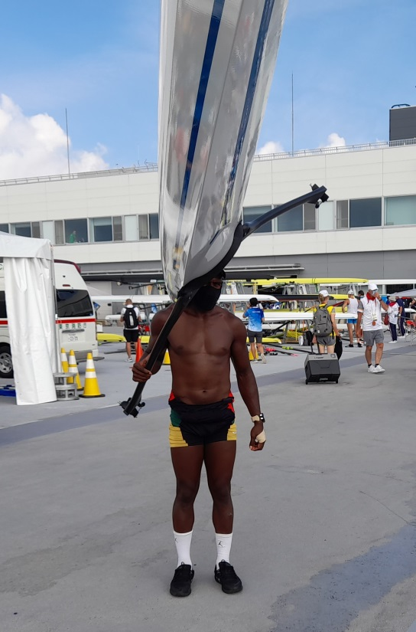
2021 Report of the OCEANIA Cont Rep
2021 Primary Achievements
Rio RII – Competed in the Tokyo Olympics
Flag bearer for Vanuatu
First competition in 18 months
Missed out on the quarter finals by a very small margin.
Successfully complete the Olympic Solidarity scholarship.
Is training to become a strength and conditioning trainer for the Vanuatu Association of Sports and Olympic Committee

Slide 4
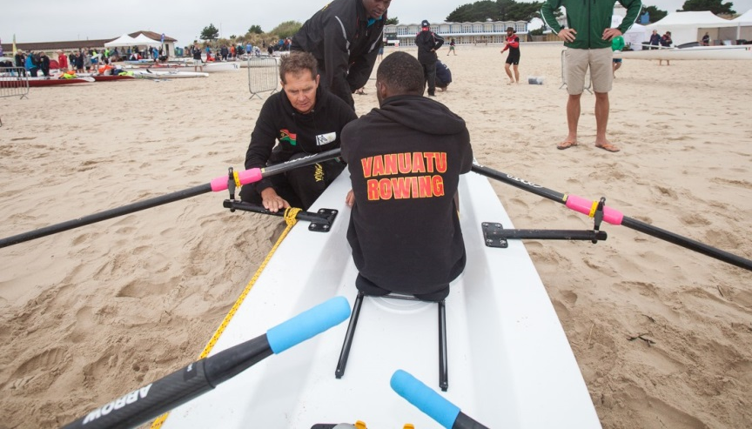
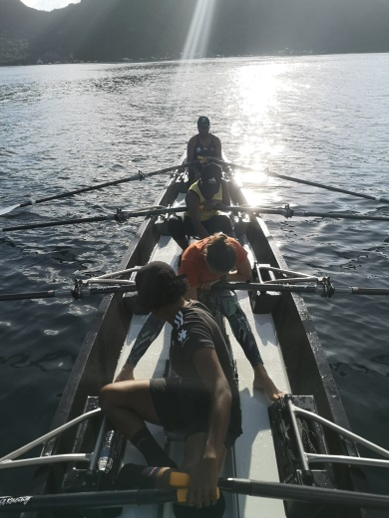
2021 Report of the OCEANIA Cont Rep
2021 Primary Achievements
Coach education program (coastal)
Andrew MacKenzie completed the first part of the WR coastal rowing coach educator course and will complete the second part in 2022.
American Samoa participated in the coastal rowing coastal module for level one completing part one (theory) online and will complete the practical in 2022

Slide 5
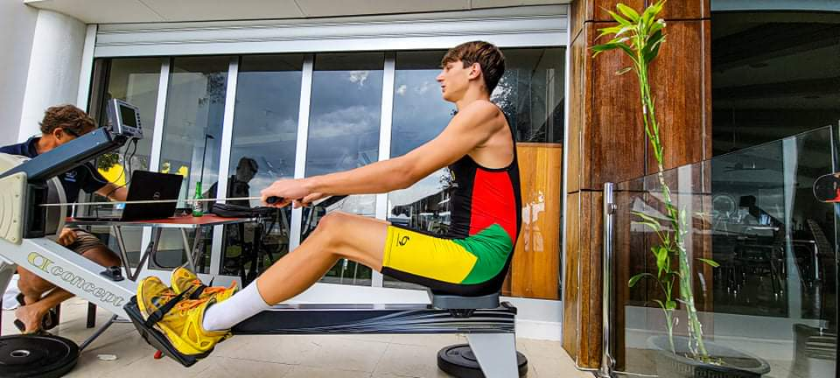
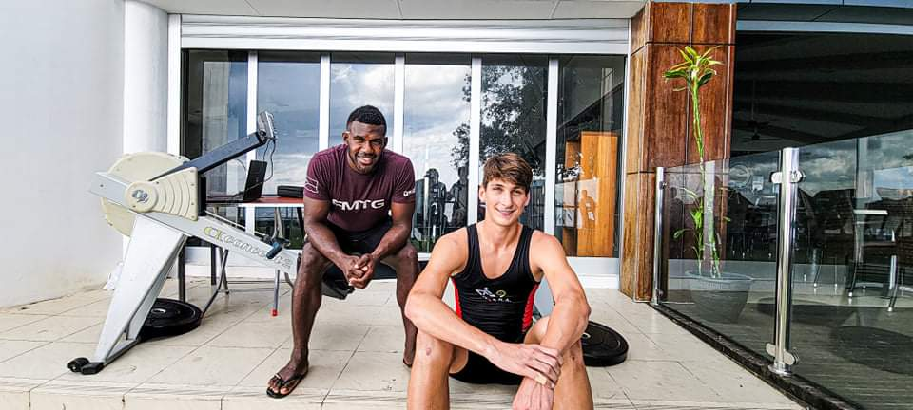
2020 Report of the OCEANIA Cont Rep
2021 Primary Achievements
Indoor Rowing
Antonie Bonke from Vanuatu won the Under 19 Oceanian Indoor rowing competition, out pacing junior rowers from Australia and New Zealand with a score of 6:08.0.

Slide 6
2022 Primary Objectives
ORCON to restructure recognizing:
Retirement of Lee Spear and Andrew McKenzie
New / current CEOs of RA and RNZ
New President of VRA
A representative of American Samoa
New Oceania Cont Rep

Slide 7
ORCON to amend constitution to allow for membership by French Polynesia (Tahiti)
ORCON to work with WR and to focus primarily on the development of rowing in the South Pacific Islands. That will primarily be coastal rowing and rowing tourism
Rather than have a part time development officer (Andrew McKenzie), the development will be primarily on projects and events for which funding will be sought.

