Slide 1


2021 Virtual
Virtual| November 2021

Slide 2

2021 Americas Report
2021 Primary Achievements
1. World Rowing Indoor Championships, CAN (virtual)
2. Americas Olympic and Paralympic Qualifier, Rio – Brazil
3. PanAm Youth qualifier, Yucatan – Mexico
4. Tokyo 2020 participation and final standings
PanAm Youth Games and TC, Cali, Colombia
6. National development projects Colombia and Uruguay
7. Digital learning and development
8. Continuous support throughout 2021
Coastal domestic events in BRA, PER and URU in addition to those in CAN and USA
South American Championships, Asunción – PAR (Dec 2021)

Slide 3
2021 Americas Report
2021 Primary Achievements
World Rowing Indoor Championships
Participating Member Federations: ARG – BRA – CAN – CHI – ECU – MEX – PAR – URU – USA
Highlights: USA - various first places in wide scope of events
ECU and MEX - 3 and 4 places in para rowing events
PAR - 2 place in M90 event
CHI - 1 place in M60 event
URU – 1 place LM U23 (Olympic athlete) and 2 place W U23

Slide 4
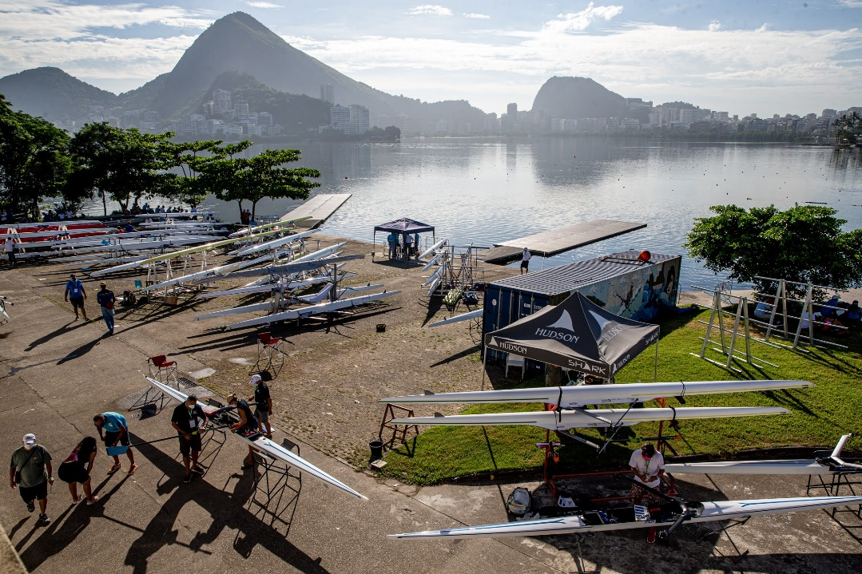
2021 Americas Report
2021 Primary Achievements
2. Americas Olympic and Paralympic Qualifier, Rio - Brazil
Working Group Concept
Pioneer event in the 2020/21 Covid context
Parallel support (psychology, anti-doping, coaching, equipment)
Successful Covid-19 Bubble
No cases during or post-event

Slide 5
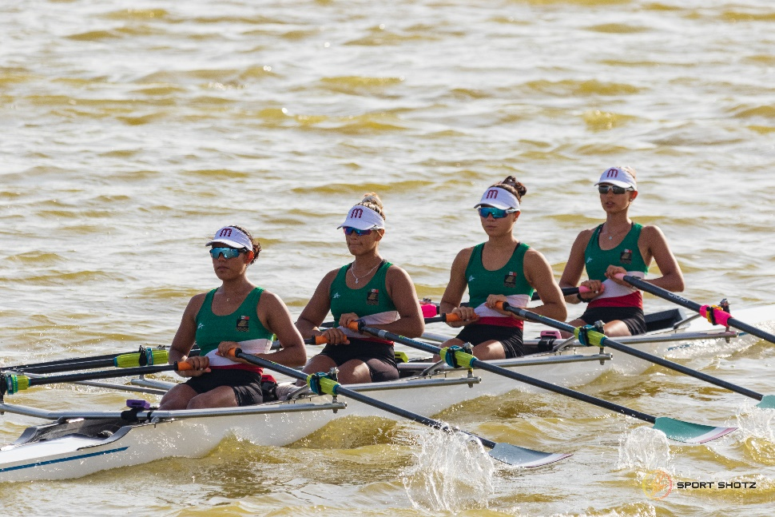
2021 Americas Report
2021 Primary Achievements
3. PanAm Youth qualifier, Yucatan – Mexico
12 countries (from which 7 got a medal)
Colombia Ecuador
Guatemala Mexico
Nicaragua Panama
Paraguay Peru
Puerto Rico Dominican Republic
Uruguay Venezuela
10 events (gender balanced) 1x 2x 4x 4- 2-
OC: Mexico MF/ COPARE/ CONADE/ MEX NOC/ Yucatan Sport Institute

Slide 6
2021 Americas Report
2021 Primary Achievements
Tokyo 2020 participation
Good communication with Hudson resulted in organised boat support and provision
Participating NOCs: ARG - BER - BRA - CAN - CHI - CUB - DOM - GUA - MEX - NCA - PAR - PER - PUR - TTO - URU - USA - VEN
Final standings maintained positions obtained in qualification regatta (87%)
3rd quota place from LW 2x not used in the continent.

Slide 7
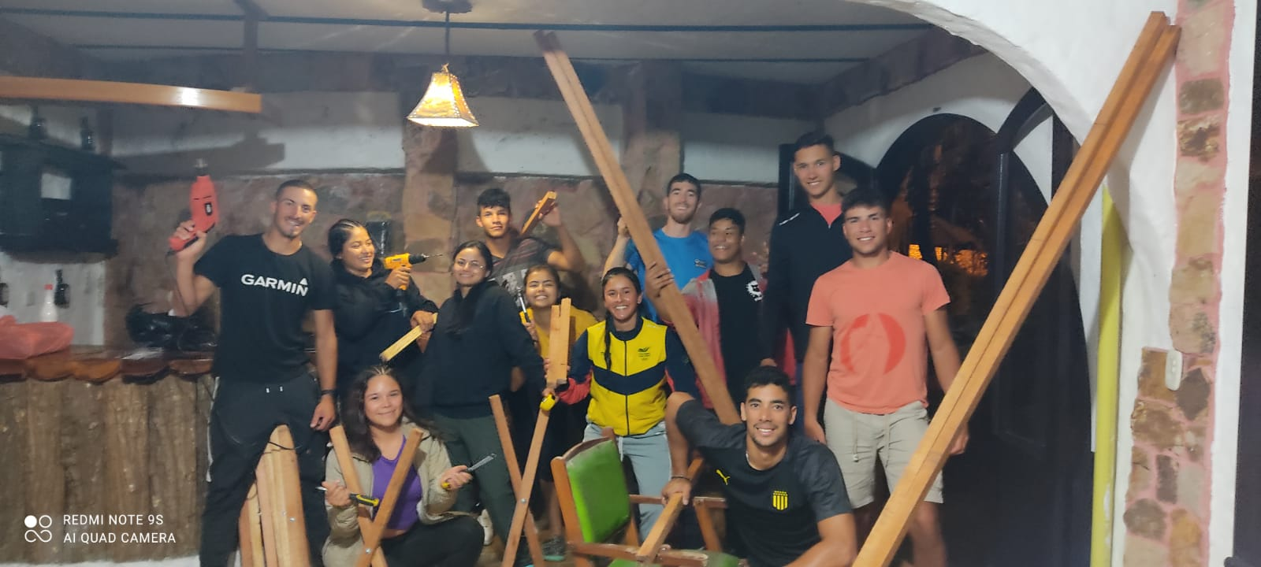
2021 Americas Report
2021 Primary Achievements
5. Training Camp and PanAm Youth Games, Cali, Colombia
Youth Athlete Development Programme – Education and Training
on Olympic Values.

Slide 8
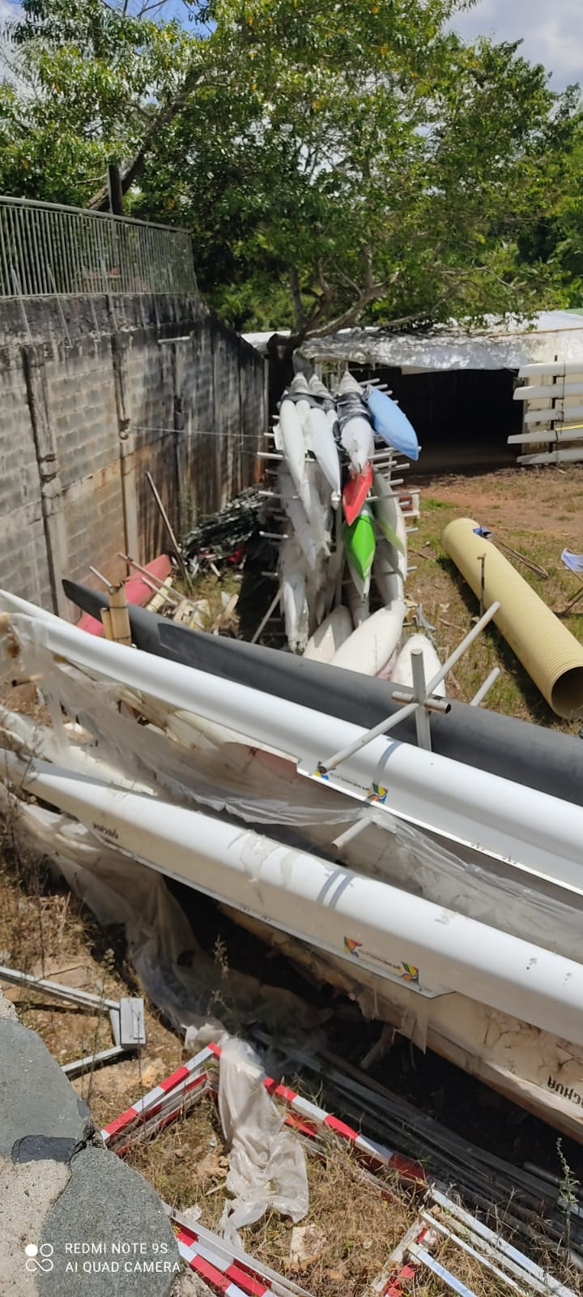
Colombia
2021 Americas Report
2021 Primary Achievements
6. National development projects
Colombia
Coach and Umpire education
National team technical support
Selection policy and test performance programme
Equipment repair and donation
Uruguay
Coach education and mentoring (including a focus on HP development pathway for female club coaches)
Oversee national coaching team
Calendars and selection policy

Slide 9


2021 Americas Report
2021 Primary Achievements
7. Digital learning and development – a means to strengthen blended learning and coaching support
Para Rowing Modules translated
and narrated in Spanish
Coastal Rowing booklet translated
into Spanish

Slide 10
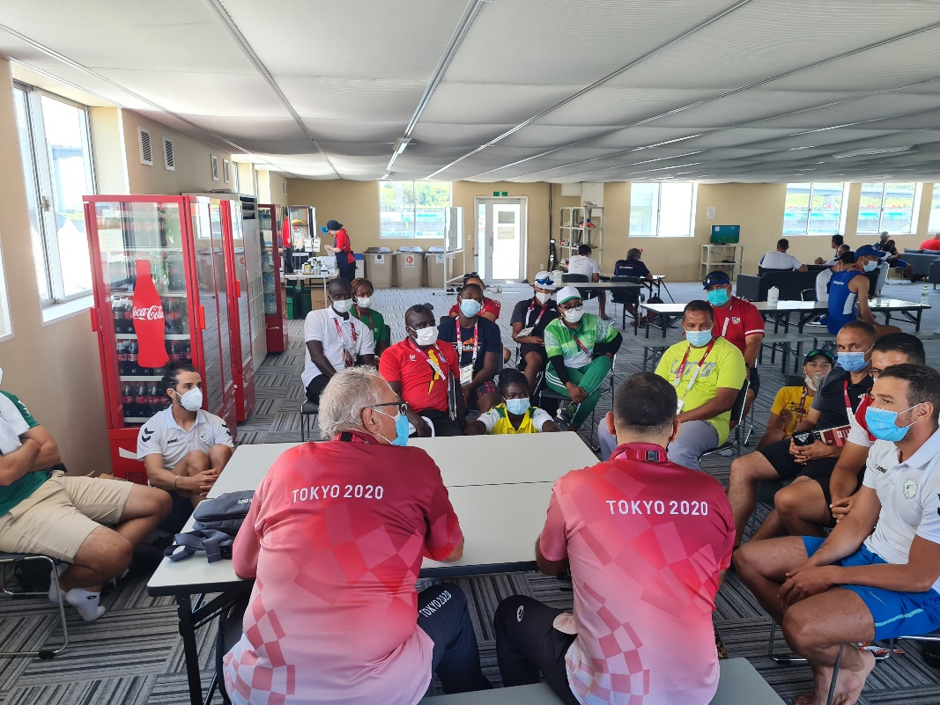
2021 Americas Report
2021 Primary Achievements
8. Continuous support throughout 2021
WR Development programme support at events
Continental Qualifier
Olympic Games
Paralympic Games
Racice WRU23CH and Plovdiv WRJCH

Slide 11
2021 Americas Report
2022 Primary Objectives
In cooperation with COPARE and CSAR, establish an improved planning process and visibility for the Americas Continental Calendar (South American CH U23+Jr, ODESUR, Central America Cups)
Continue to roll out the new WR Coach Education Programme
Shape digital strategy for test performance programme and coaching education as a complement to the essential on site courses/ training camps and events
Strengthen support to regional and continental events for coastal and para and introduce/ reinforce education, guided coaching sessions and training camps prior to events

