Slide 1


2021 Virtual
Virtual| November/December 2021

Slide 2

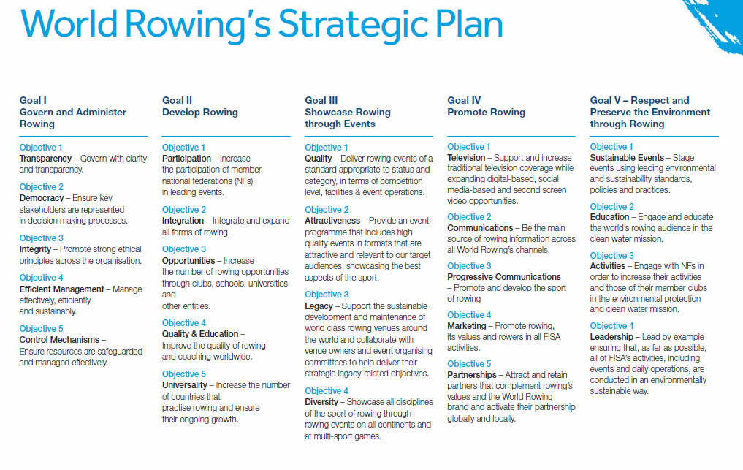

Development Team meetings with the Exec Comm
Meetings with the Executive Committee and each Continental Rep highlighted much of the work in 2021 and the planning for 2022 for the development areas.
This presentation will serve as an overview of other topics not covered and to provide the overall framework for the work in 2022 and the critical planning for future subject to the World Rowing strategic plan

Slide 3
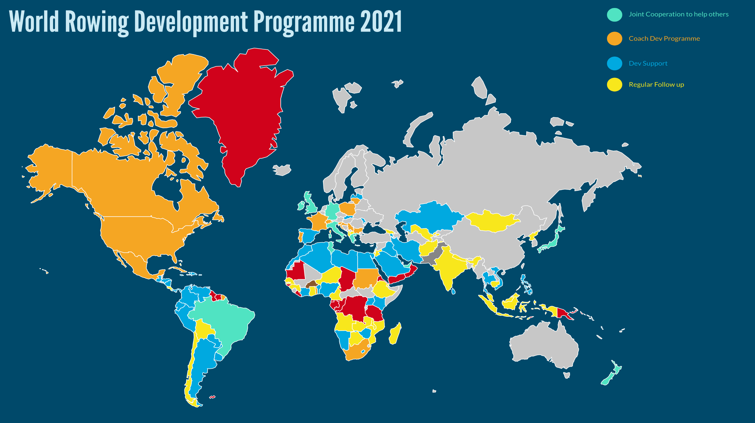
World Rowing
Development Programme reach

Slide 4
2021 Report from Development
2021 Primary Achievements
1. Pathway to the Olympics
OPQR
Liaison with MFs during OPQR decision making process
Assist in getting teams to the three Continental OPQR
Organise equipment
Project management - OPQR Working Groups
OS Scholarships
BEN, LBA, NAM, TOGO, VAN, KIR

Slide 5
2021 Report from Development
2021 Primary Achievements
Pathway to the Olympics
Tripartite
Liaison with OS and project management
Bipartite (timeline and process development)
OG and PG Boats
Freight Support Plan support

Slide 6
2021 Report from Development
2021 Primary Achievements
1. Pathway to the Olympics
Notes:
X nr of nations Qual events
Y Worlds
Statistics
Huge reach dev team
Improve numbers
Include Map
Strategic Objectives

Slide 7
2021 Report from Development
2021 Primary Achievements
1. Pathway to the Paralympics

Slide 8
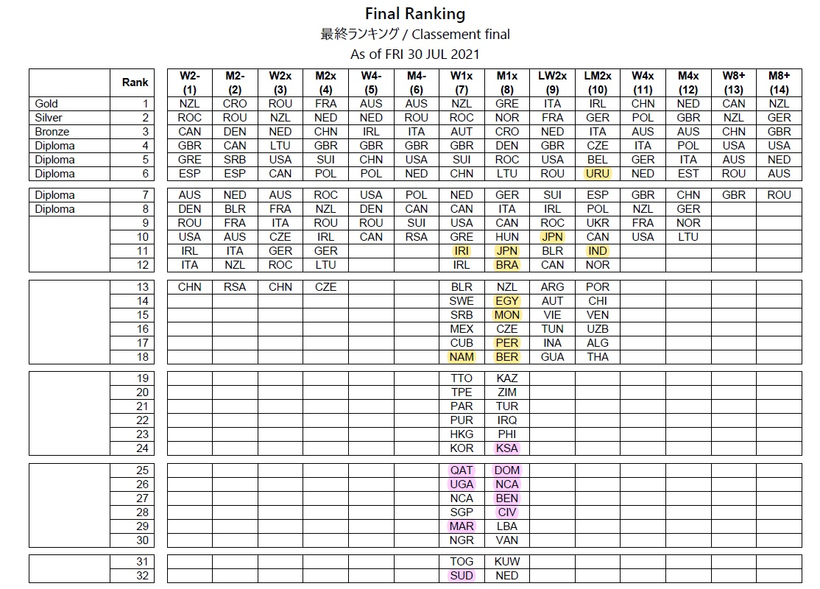
2021 Report from Development
2021 Primary Achievements
Improved quality from dev nations
Notes:
Developing nations in FB and FC
Times in Races

Slide 9
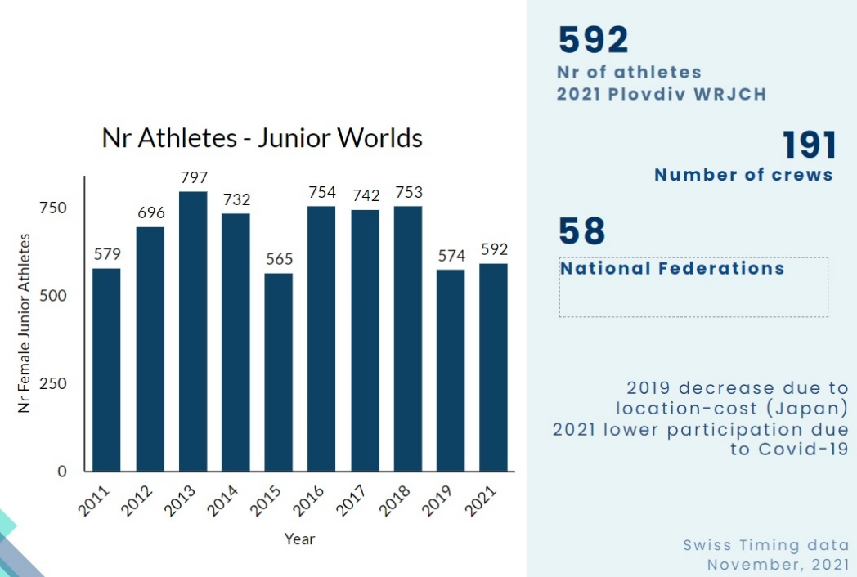
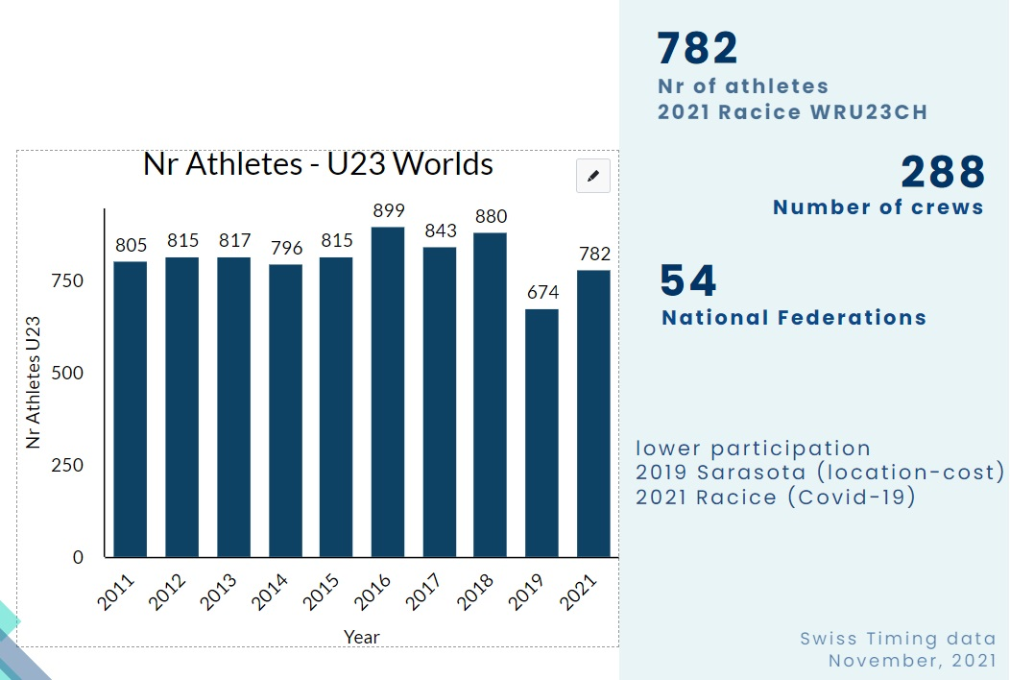
2021 Report from Development
2021 Primary Achievements
2. MF Support
DP Event support and training camps
Worlds (U23+Juniors)
Four Continental Games and Chps
Training Camps (Piediluco and Gavirate) – Africa
Good levels of participation given the Covid context

Slide 10
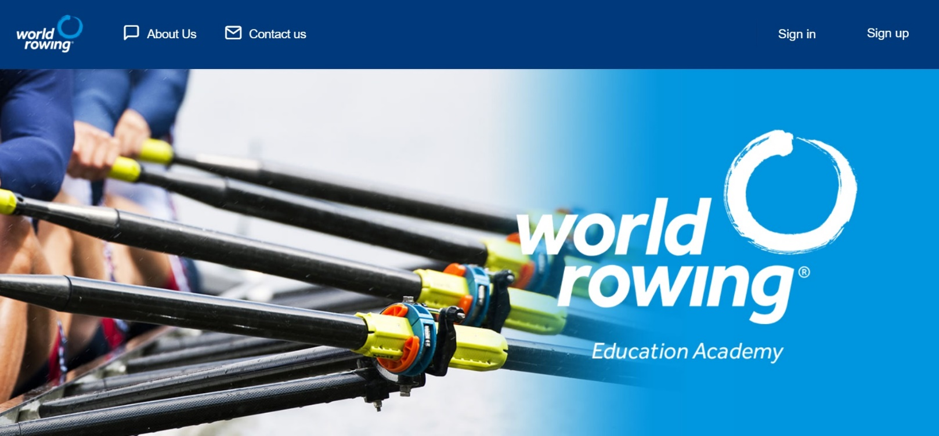
2021 Report from Development
2021 Primary Achievements
3. https://academy.worldrowing.com
Learning hub
Platform to educate and develop

Slide 11
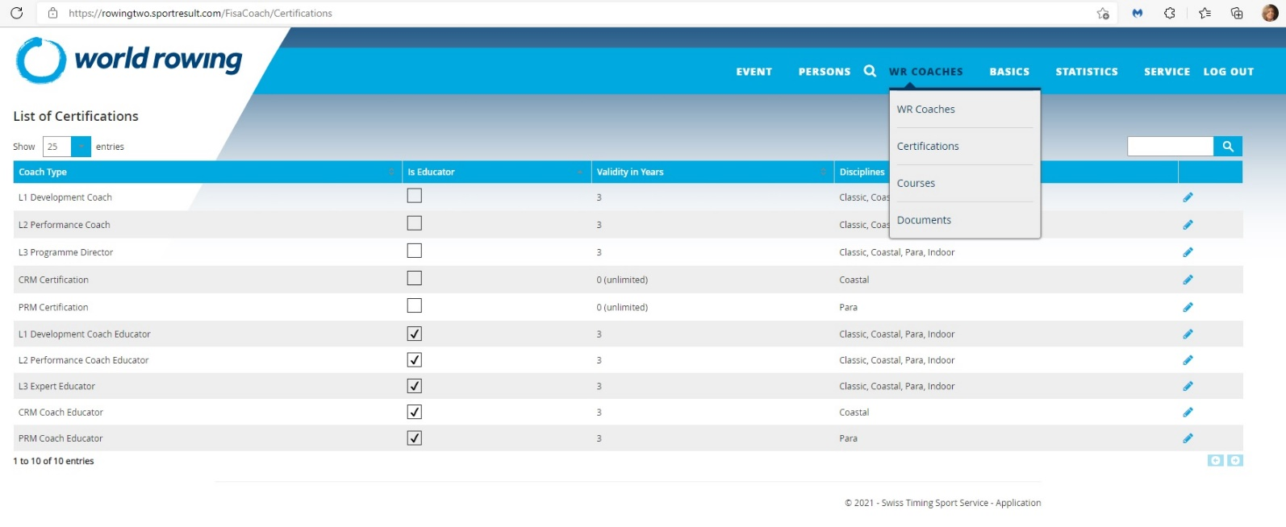
2021 Report from Development
2021 Primary Achievements
3. https://academy.worldrowing.com
Launch IPC GSI with two online courses
Para Rowing Modules (CDP) 10 modules
Introduction Para Rowing Classification (CAP authoring) 8 modules
4. Database

Slide 12
2021 Report from Development
2021 Primary Achievements
4. Continued Roll Out of Coach Education
Developed MF Partnership Model
series of CRM online courses - CAN Jan, USA April and June
and face to face courses - CRO November, POR September
guided coaching sessions - UAE November (Safety focus)
New projects secured
Cape Verde (Coastal Level 1 course)
Colombia (national development)
Uruguay (national development)
Reached coaches from 25 countries

Slide 13
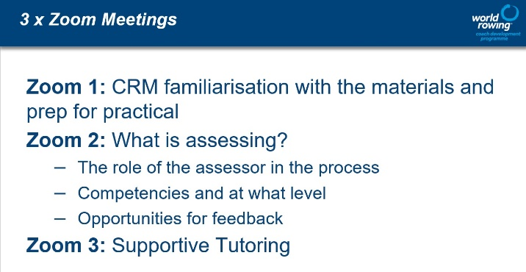
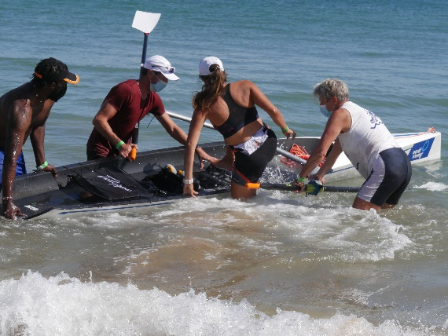
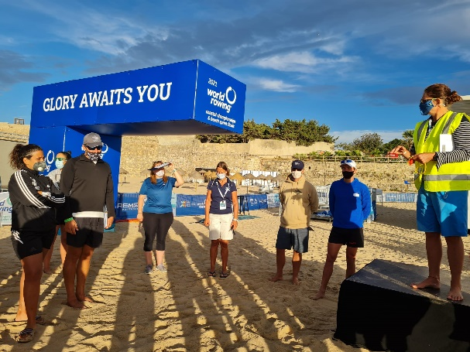
2021 Report from Development
2021 Primary Achievements
4. Continued Roll Out of Coach Education
Oeiras CRM and Coastal L1 Coach Educator training
first in-person coaching education entirely focused
on coastal rowing
Classic L1 Coach Educator online training – Americas
Key activities to roll our work in continents

Slide 14
2021 Report from Development
2021 Primary Achievements
5. General Support & others
Calculation of MF Voting Rights 2021-2024
Subscription Fees
GEDI WG – Roadmap Project Management
Women in coaching toolkit
MF Survey
WLS application process

Slide 15
World Rowing Member Federation Survey
Update 7 Dec 2021
78%
156 Member Federations
121 responses
422000
rowers

Slide 16
2021 Report from Development
2022 Primary Objectives
Coach Educators Roll out
Strengthen Coach Development Programme
Education and training aligned with Regional-Continental Calendars
Strengthen cooperation with Continental Confederations and Commissions
Individualised support to MF considering contexts and needs
(discipline based approach to rowing expansion)

