Slide 1


2021 Virtual
Virtual| November/December 2021

Slide 2

2021 Asia Report
2021 Primary Achievements
Asia Olympic and Paralympic Qualifier, Tokyo – Japan
Arab Beach Sprints, Dubai, UAE
Tokyo OG and MF Meetings
National Development Planning (Palestine, Lebanon rebuilding)
Continuous support throughout 2021

Slide 3
2021 Asia Report
2021 Primary Achievements
1. Asia Olympic and Paralympic Qualifier, Tokyo - Japan
18 MFs competed
Excellent coordination with OC and WR – regular working group meetings
Competitive racing with improved Asian standards
17 MFs have ultimately qualified for the OG
Para events offered for the first time at the Continental Qualification. It attracted 5 MFs to join, namely IND, JPN, THA, SRI, and UZB. JPN and SRI took the qualifying slots PR1W1x and PR1M1x.
Notes:
AOOPQR - Was successfully hosted on 6-7 May in Tokyo and I would like to extend my gratitude to the JPN Government, JARA, Nathalie, Buchi and their whole team in Tokyo for making this event possible despite all of the huge challenges.
WR Development Team -There was also lots of coordination and support provided by the WR Development Team who met weekly with OC and key event officials in the months leading up to the event. Special thanks also to the team of Development Coaches on the ground in Tokyo who provided support to developing countries and liaison between the OC and teams.
18 MFs competed. Unfortunately teams from UAE and VAN (Vanuatu) and the KOR M1x had to withdraw before the event due to travel or other related restrictions.
Race Standard - Despite the worldwide pandemic, races were extremely competitive in the finals of all four events - W1x, M1x, LW2x and LM2x. It was very exciting to see such a high standard of preparation by teams and how seriously they treated the competition.
Fairness - special thanks to Mike Tanner for traveling to Tokyo and leading the Fairness Commission. His experienced presence on the ground was very helpful to the OC and reassuring to teams when weather was changeable. Thanks also to Koji join the Commission, provided practical weather forecast for monitor the fairness condition and Victor be the Technical Delegate. We all worked very closely with OC in Tokyo.

Slide 4
2021 Asia Report
2021 Primary Achievements
2. Sharjah 2021 Arab Championship Rowing Beach Sprint,
11 countries (from which four were from Asia)
BHR KUW PLE UAE
OC: Sharjah Sports Council and the UAE Sailing and Rowing Federation.
CM1x | CW1x | CMix2x
CJM1x | CJW1x | CJMix2x
CBM1x | CBW1x | CBMix2x
CM2x | CW2x
CJM2x | CJW2x
CBM2x | CBW2x
Notes:
We met with BHR - KUW to discuss future collaboration and support during 2022 + PLE to discuss more about the DNSS and the MF plans for the future

Slide 5
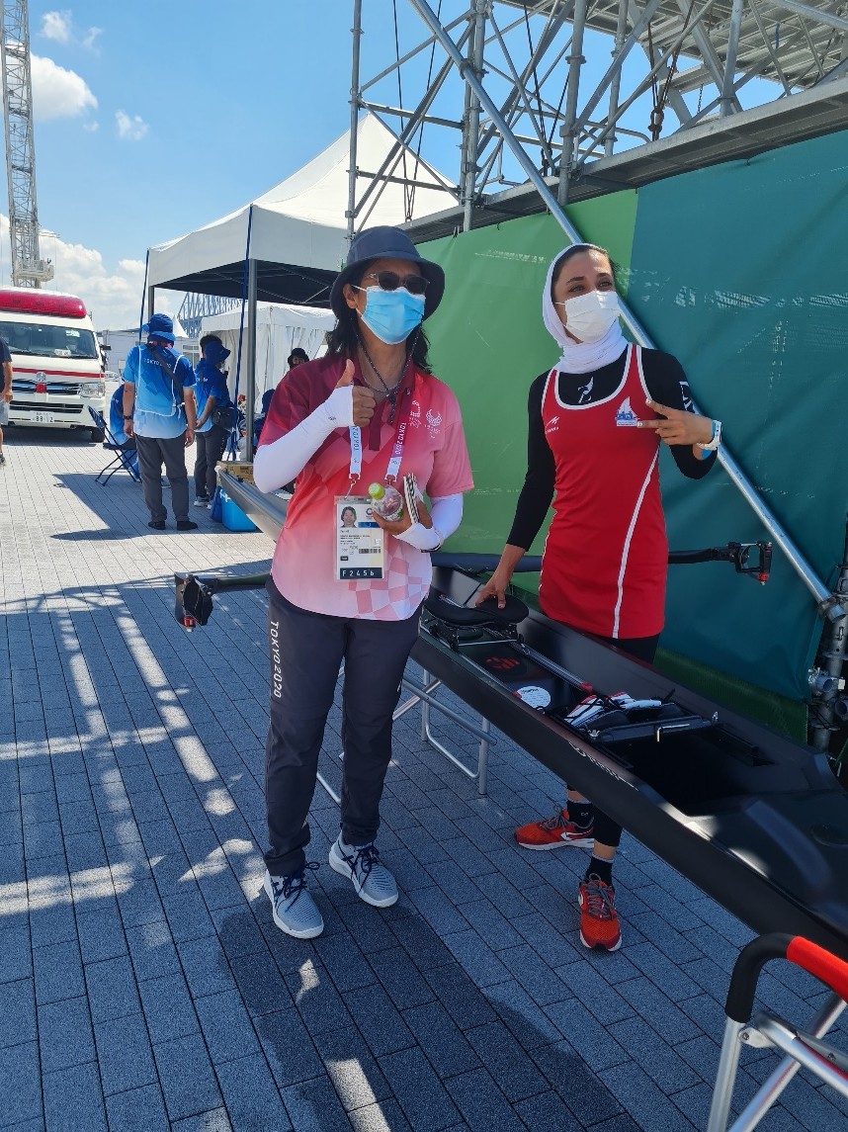
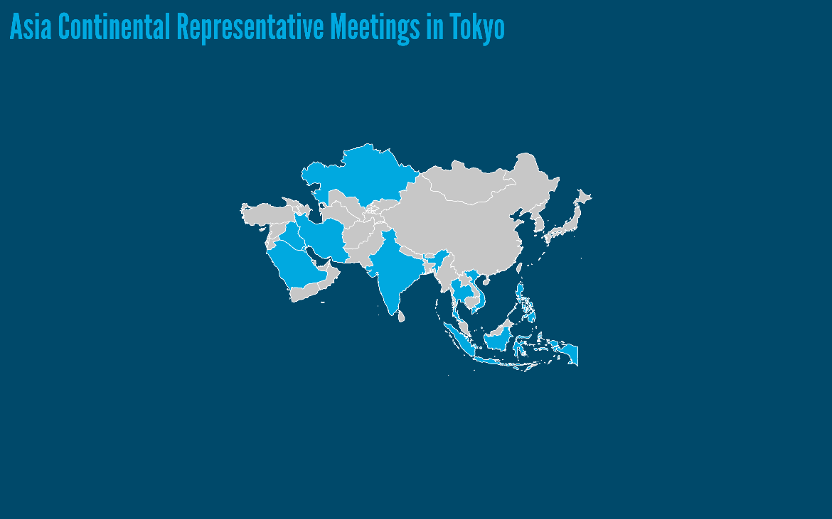
2021 Asia Report
2021 Primary Achievements
3. Tokyo OG & MF Meetings
17 qualified NOCs from Asia
Three medals (CHN)
Meetings with 11 NFS in Tokyo
IRI - Malaei ranked 11th in Tokyo
Notes:
Meetings with 11 NFs/NOCs
INA
IND
IRI
IRQ
KAZ
KUW
PHI
KSA
SGP
THA
VIE
This year we meet with:
UZB - LBN - Jordan NOC - PAK - Maldives - SRI)

Slide 6
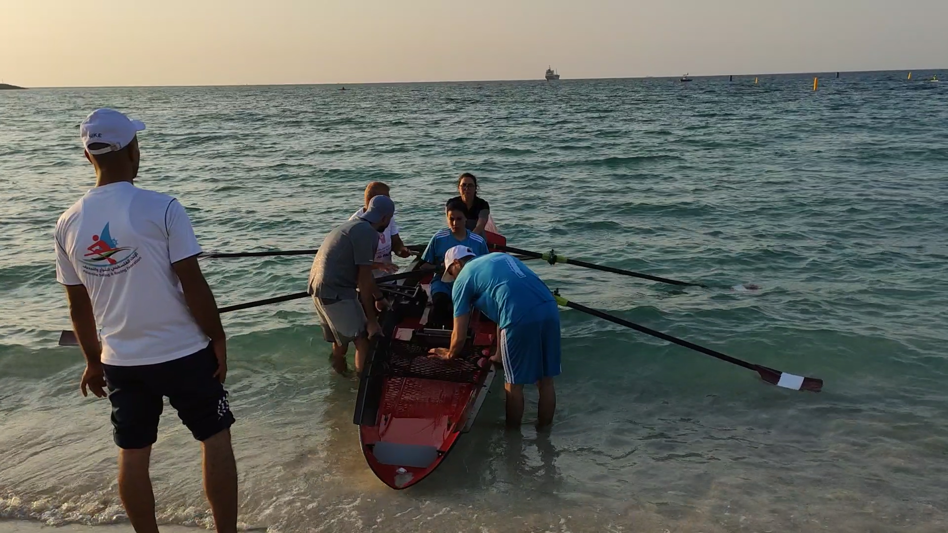
Colombia
2021 Asia Report
2021 PrimaryAchievements
4. National Development Planning
Palestine
First appearance in Dubai
Currently working to approve a tailor-made project
Set up a national sport structure
Equipment
Education and training
Coastal Rowing
Lebanon rebuilding project
Notes:
Contact with Amel Younis as an expat palestinian athlete in classical rowing

Slide 7
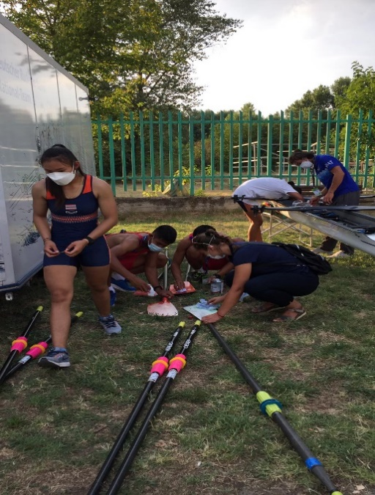
2021 Asia Report
2021 Primary Achievements
5. Continuous support throughout 2021
WR Development programme support at events
Asia Continental Qualifier (WR DP support 13 NFs)
Plovdiv WRJCH (only Thailand)
Meetings/calls with Asia NFs (20 out of 37 members)
INA, IND, IRI, IRQ, KAZ, KUW,PHI, KSA, SGP, THA,TPE
VIE, UZB, LBN, Jordan NOC, PAK, PLE, MDV,SRI, BRN
Eight out of 37 have been identified as inactive
(AFG, BAN, JOR, KGZ, MON, NEP, SYR, TKM)
26 (78%) out of the 30 active responded to the WR survey – still chasing more
Maldives – following up after Schools Beach Sprint – donation ergos, sculls, DNSS?
Notes:
SRI – PHI – SGP – KSA – VIE – THA – KAZ – IRQ – IRI 9
Equip only (QAT, UZB, IND, KUW) 4

